Slide 1
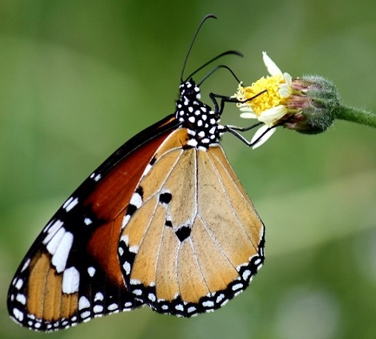
BUTTERFLIES OF LEBANON a student’s pictorial guide to field identification
Husein Zorkot
HHI Park Butterfly Garden & Pavilion
Field Manager/Butterfly Expert & Lepidopterist
Lebanon Butterfly Monitoring Scheme (LBMS)
Butterflies and Moths of Lebanon LEPIDOPTERA LIBANOTICA
Attribute: Anton Croos (Wikipedia Creative Commons)

Slide 2
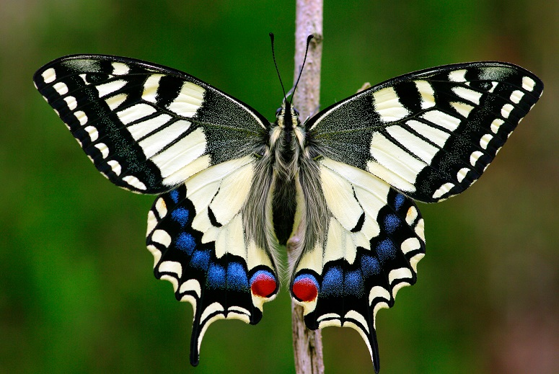
Common swallowtail Papilio machaon syriacus Large Black and yellow Characteristic red hindwing eyespots Long tails
Attribute: Entomolo (Wikipedia Creative Commons)

Slide 3
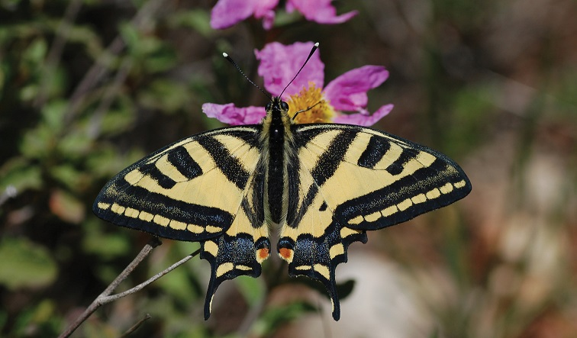
Tiger swallowtail Papilio alexanor maccabaeus Large Black and a deeper yellow Single wide black markings Orange hindwing eyespots Long tails
Attribute: Albert Vliegenthart (Wikipedia Creative Commons)

Slide 4
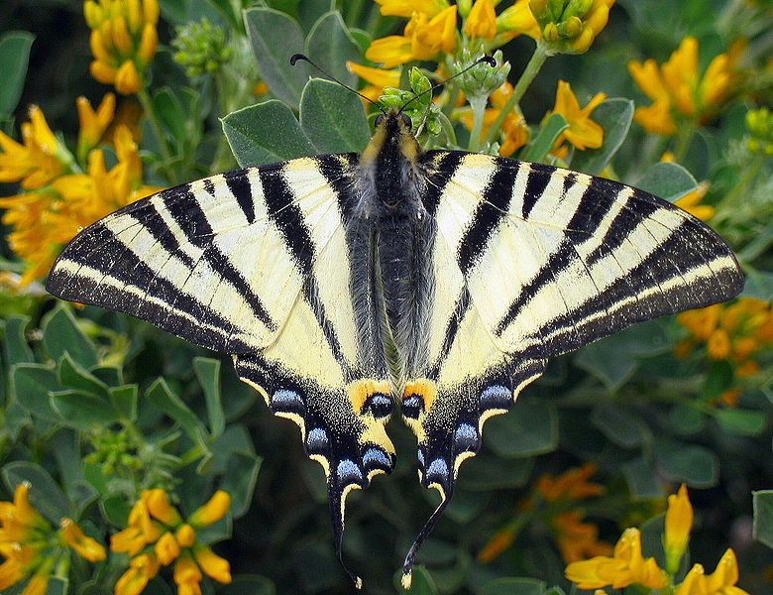
Pear-tree swallowtail Iphiclides podalirius virgatus Large Black and a paler yellow Paired black markings Yellowish hindwing eyespots with inverted blue colour Long tails
Attribute: Tbc (Wikipedia Creative Commons)

Slide 5
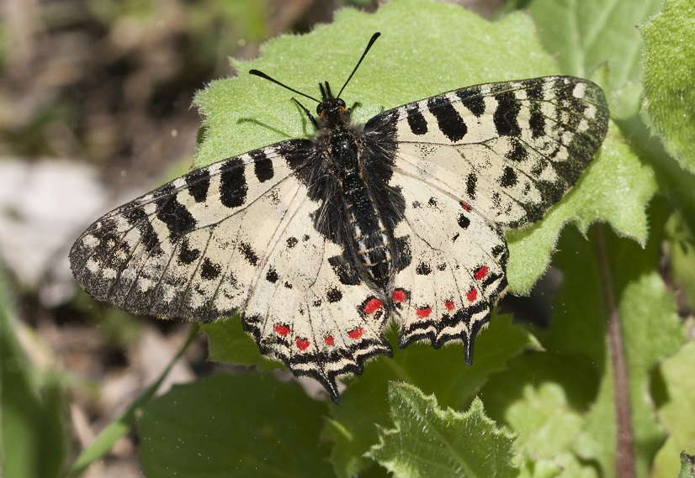
Eastern festoon Allancastria cerisyi speciosa Medium-sized Black and yellowish-white Shorter tails, only one projecting Red spotting on hindwings
Attribute: Zeynel Cebeci (Wikipedia Creative Commons)

Slide 6
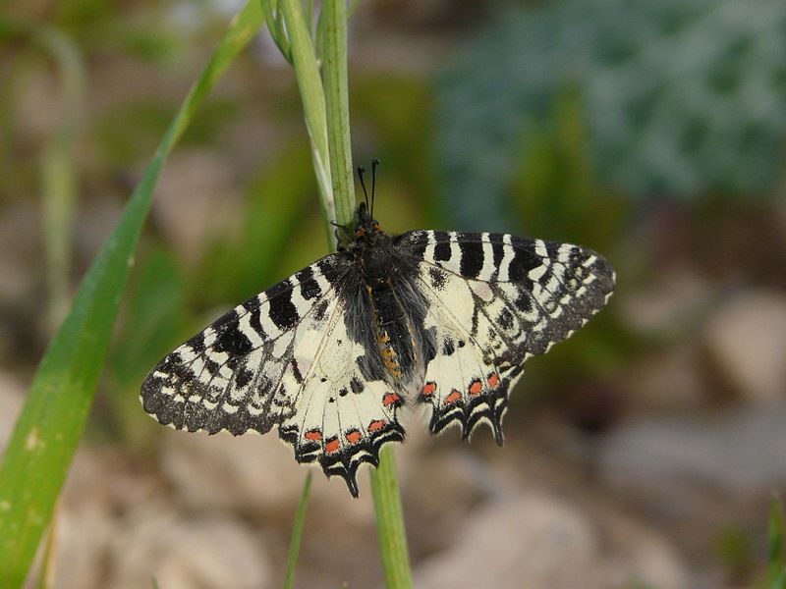
Lebanese festoon Allancastria deyrollei eisneri Medium-sized Black and yellowish-white Shorter tails, three projections Red spotting on hindwings
Attribute: Alastair Rae (Wikipedia Creative Commons)

Slide 7
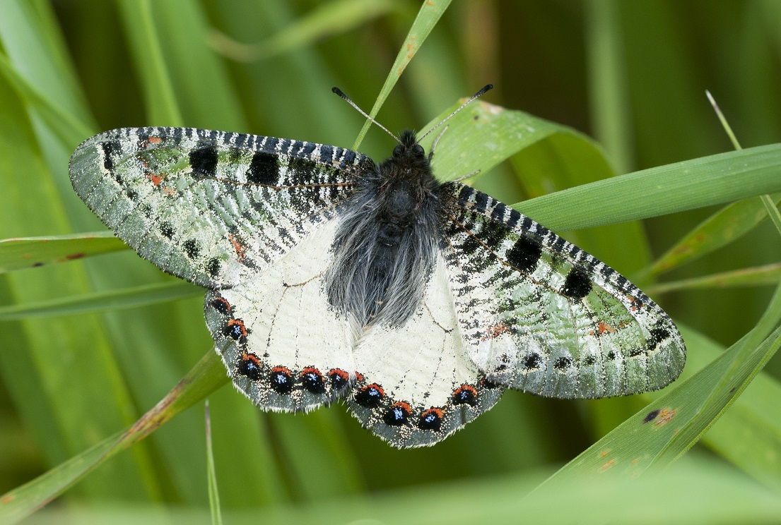
False Apollo Archon apollinus bellargus Medium-sized Grey semitransparent forewings White hindwings Not tailed
Attribute: Zeynel Cebeci (Wikipedia Creative Commons)

Slide 8
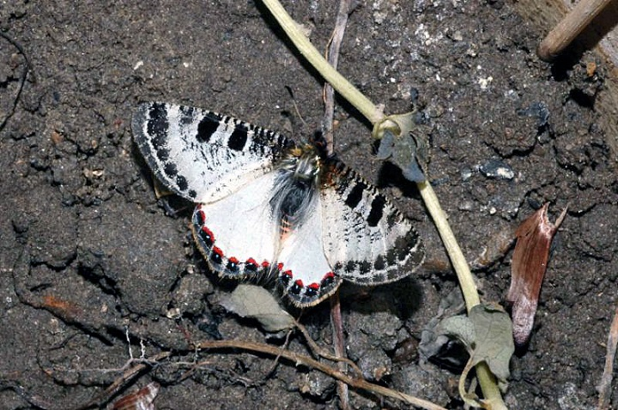
Little false Apollo Archon apollinaris Medium-sized but smaller than the false Apollo Grey semitransparent forewings Darker forewing markings White hindwings Not tailed
Attribute: Frederic Carbonell (Wikipedia Creative Commons)

Slide 9
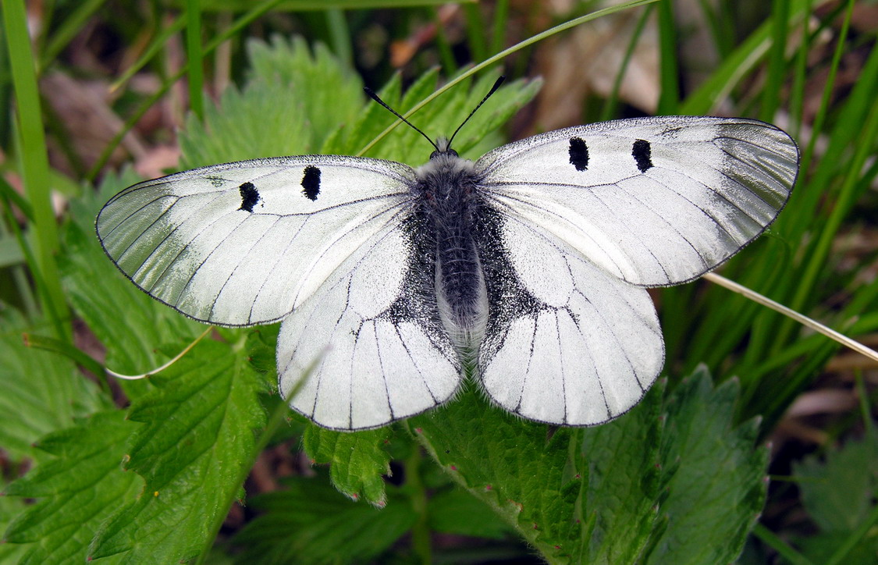
Clouded Apollo Parnassius mnemosyne Large Distinct white semitransparent wings Few spots
Attribute: Algirdas (Wikipedia Creative Commons)

Slide 10
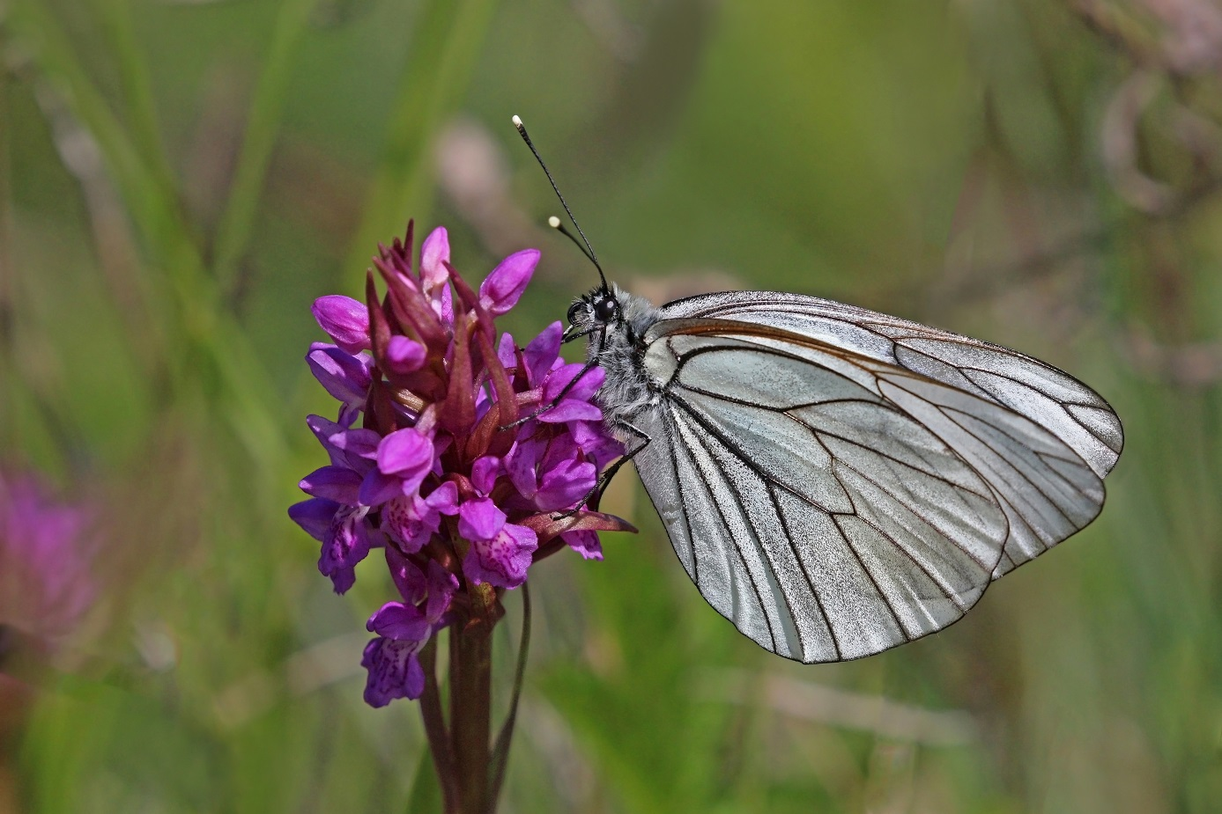
Black-veined white Aporia crataegi augustior Large Glassy semitransparent white wings Distinct black veins
Attribute: Sharp Photography (Wikipedia Creative Commons)

Slide 11
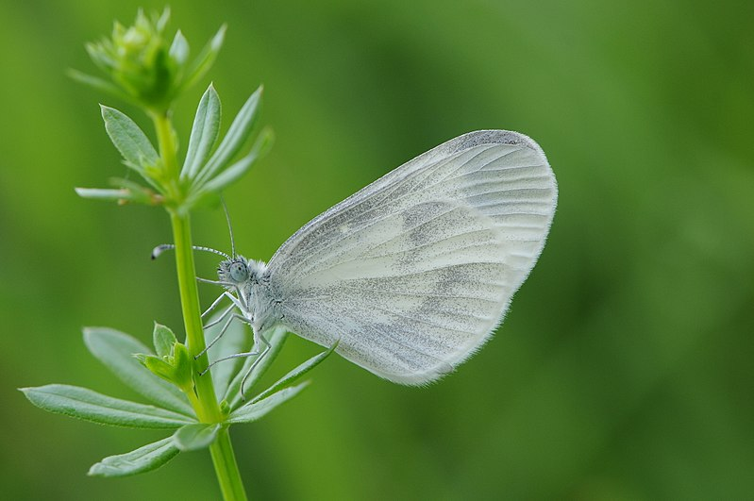
Wood white Leptidea sinapis Small Powdery white wings Slow and low flight
Attribute: Bohringer Friedrich (Wikipedia Creative Commons)

Slide 12
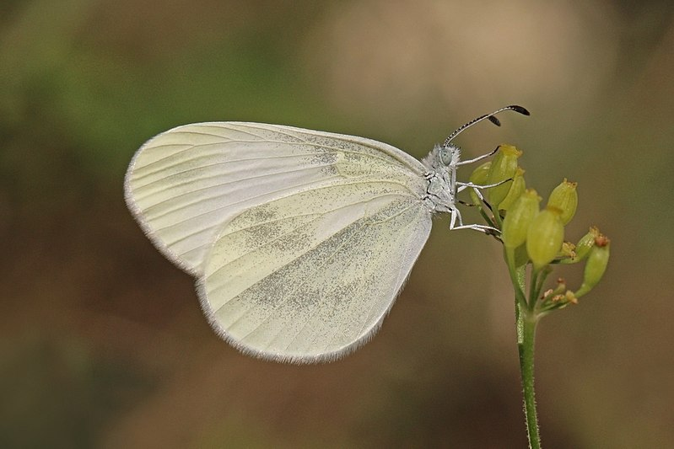
Eastern wood white Leptidea duponcheli xanthochroa Small Powdery yellowish wings Brownish antennae
Attribute: Sharp Photography (Wikipedia Creative Commons)

Slide 13
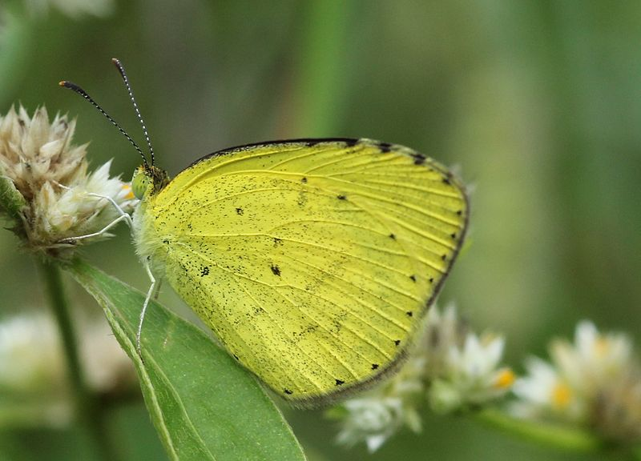
Broad-bordered grass yellow Eurema brigitta brigitta Small Yellow and black wings Tiny dots
Attribute: Chinmayisk (Wikipedia Creative Commons)

Slide 14
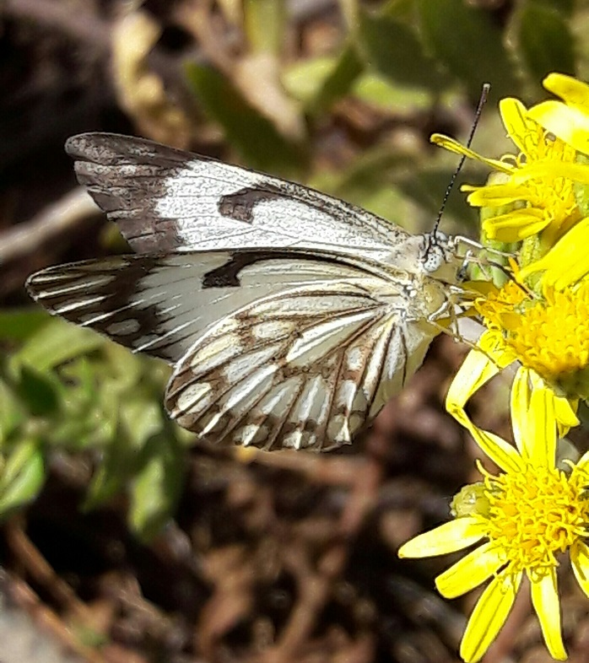
Caper white Belenois aurota aurota Medium-sized Creamy white wings and black markings
Attribute: Husein Zorkot

Slide 15
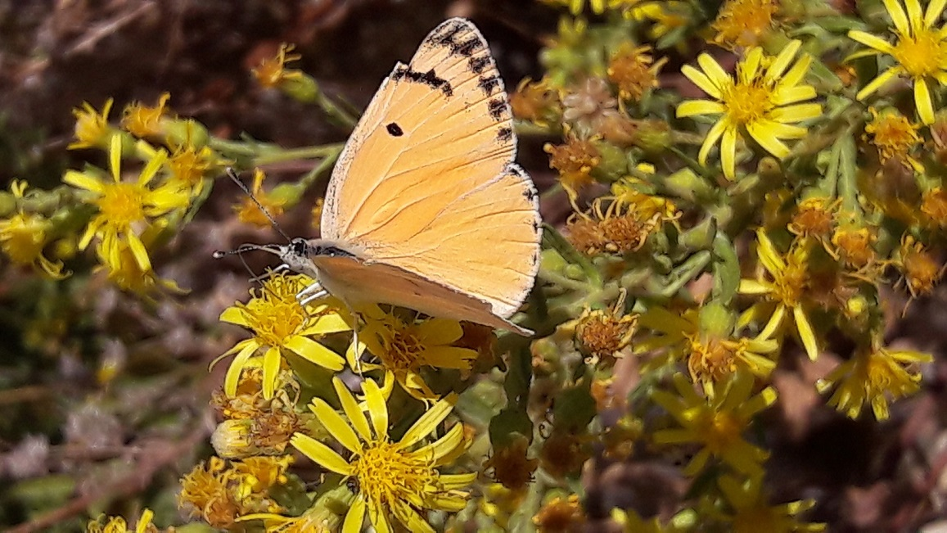
Salmon caper Colotis fausta fausta Small Light salmon buff colour and black markings
Attribute: Husein Zorkot

Slide 16
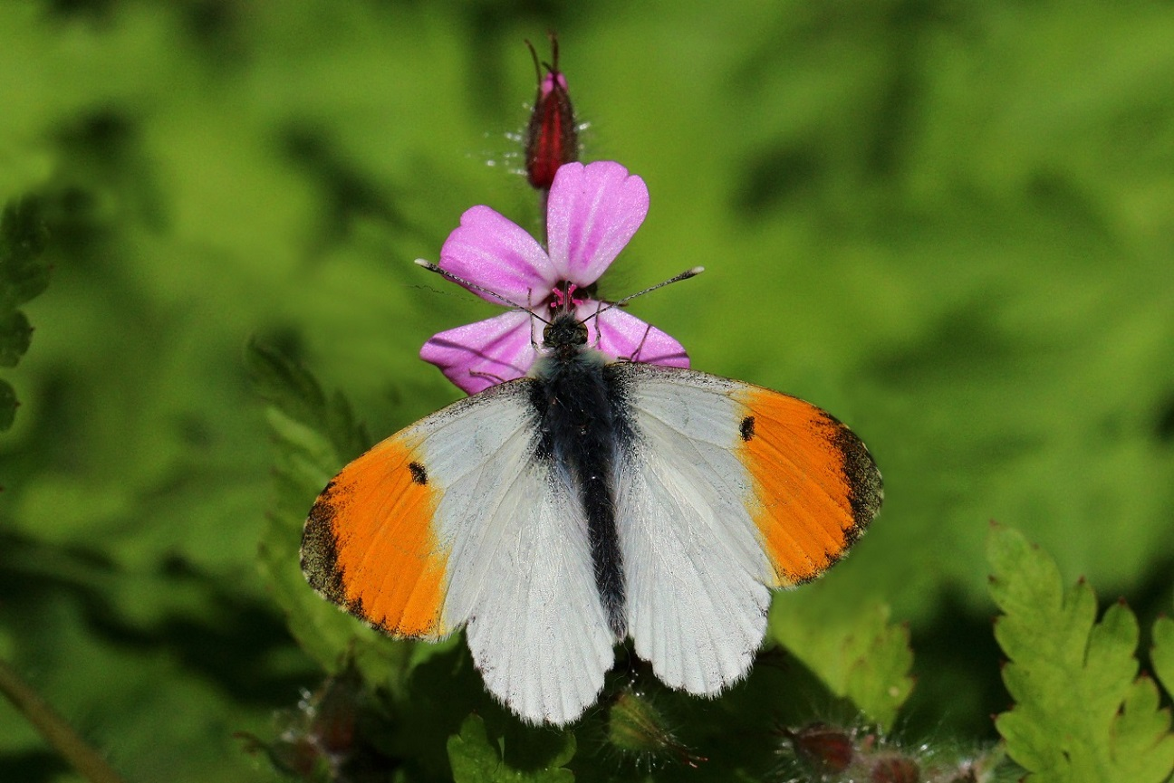
Orange-tip Anthocharis cardamines phoenissa Medium-sized White wings with brownish-black dots and borders Orange patches on forewings
Attribute: Sharp Photography (Wikipedia Creative Commons)

Slide 17
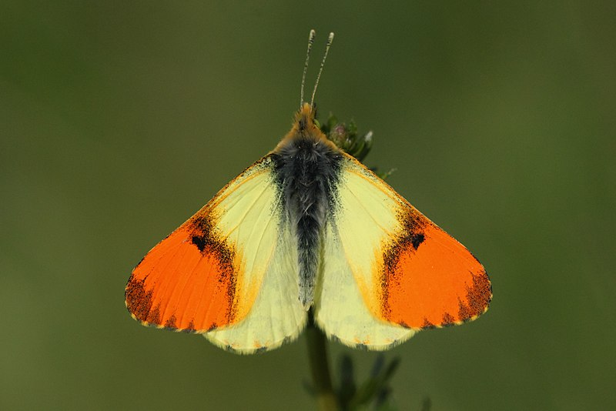
Eastern orange-tip Anthocharis damone syra Medium-sized Yellow wings with brownish-black dots and borders Orange patches on forewings
Attribute: Dennis Sanetra (Wikipedia Creative Commons)

Slide 18
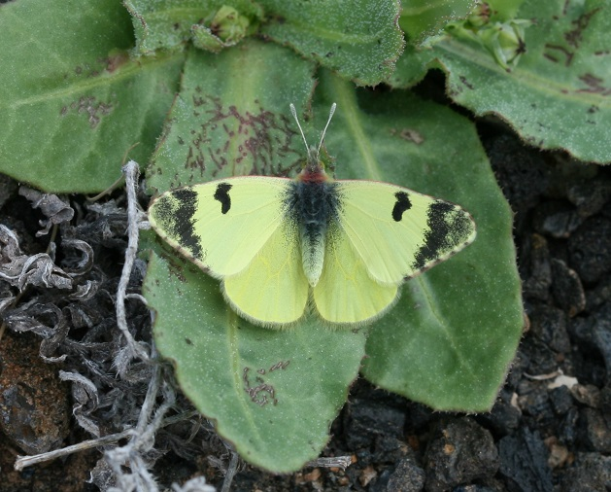
Greenish black-tip Euchloe charlonia charlonia Small Greenish-yellow wings Black forewing patches and markings
Attribute: Silversyrpher (Wikipedia Creative Commons)

Slide 19
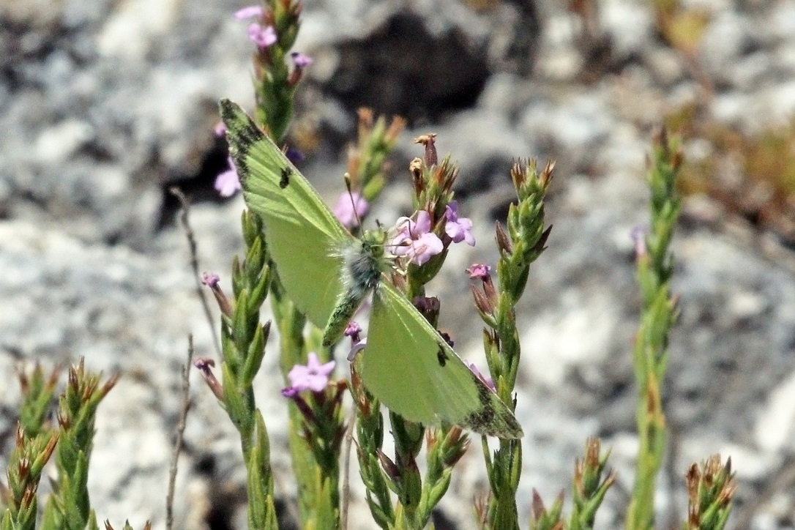
Eastern greenish black-tip Euchloe penia penia Small Greenish wings, less yellow Black forewing patches and markings
Attribute: Sharp Photography (Wikipedia Creative Commons)

Slide 20
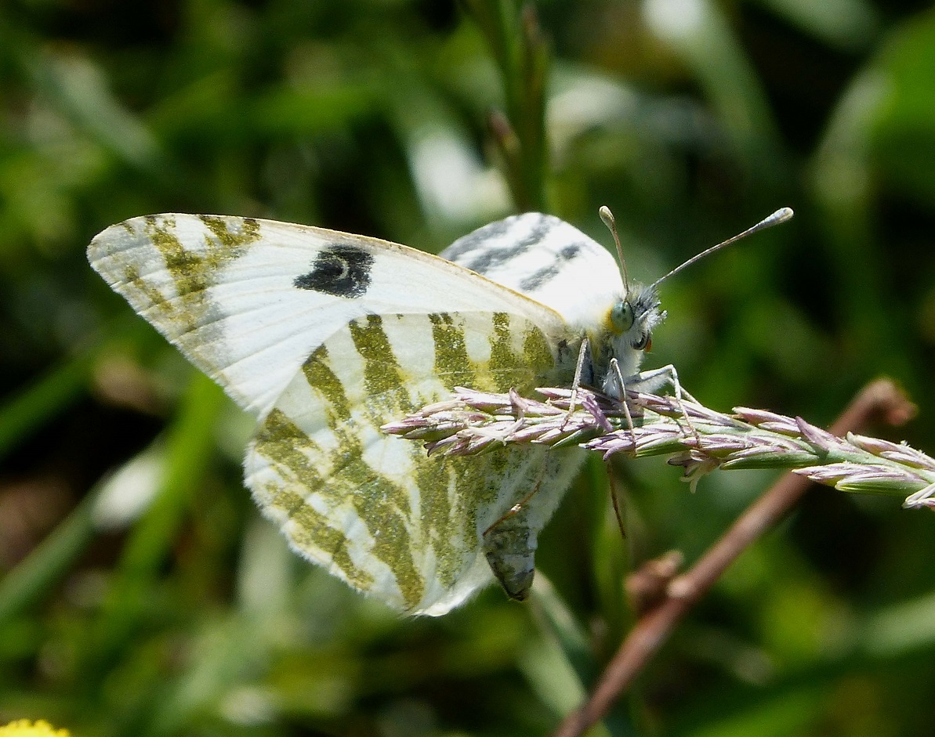
Green-striped white Euchloe belemia belemia Small to medium-sized White with greenish markings on the undersides
Attribute: gailhampshire (Wikipedia Creative Commons)

Slide 21
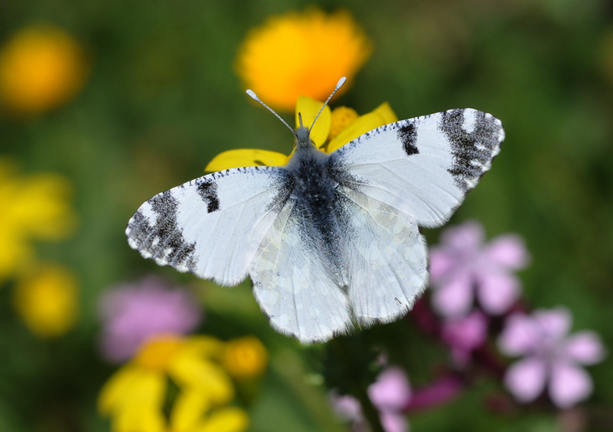
Dappled white Euchloe ausonia Small to medium-sized White with blackish markings Dark green on the undersides
Attribute: Zeynel Cebeci (Wikipedia Creative Commons)

Slide 22
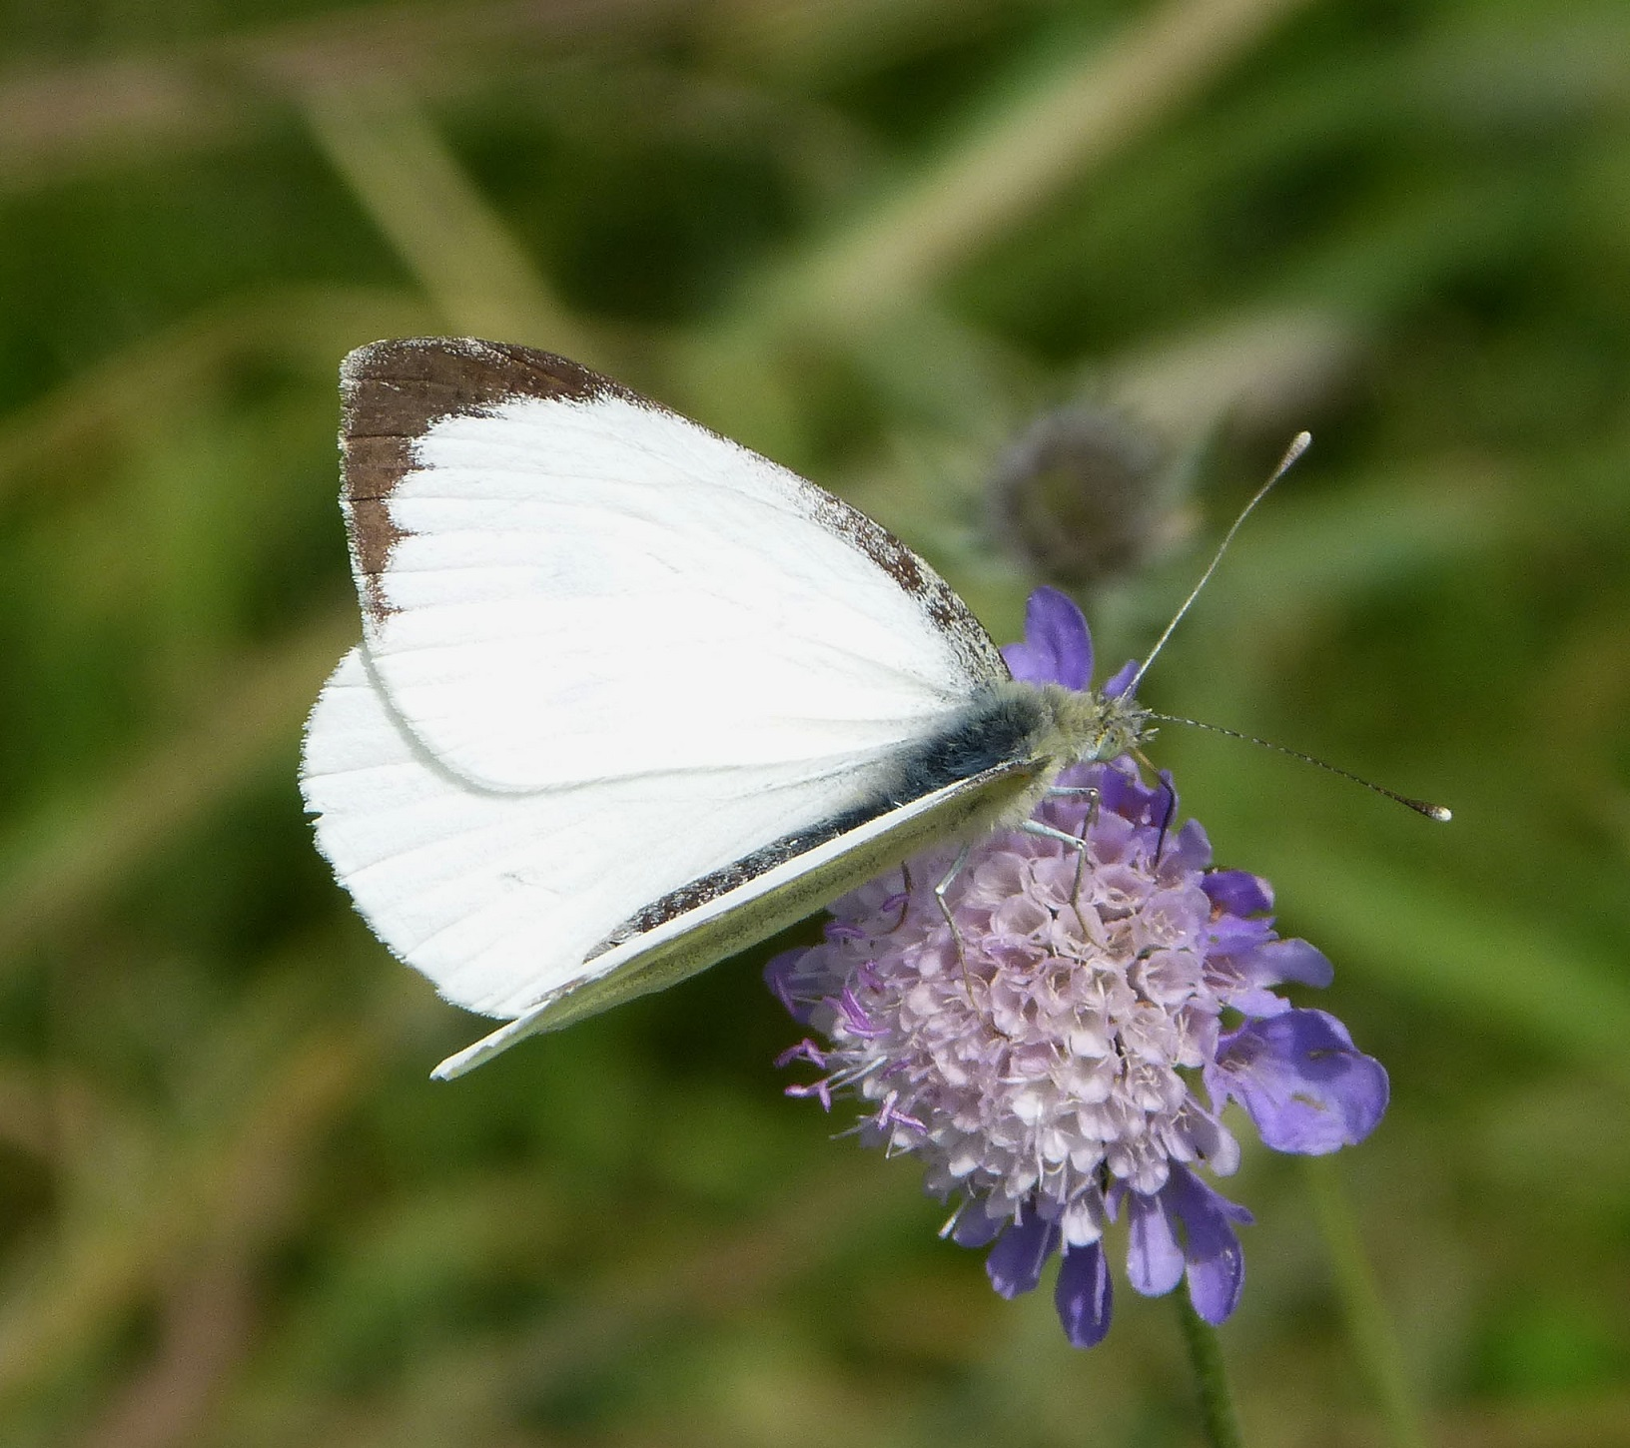
Large white Pieris brasssicae catoleuca Large White with characteristic black spots and wing tips
Attribute: gailhampshire (Wikipedia Creative Commons)

Slide 23
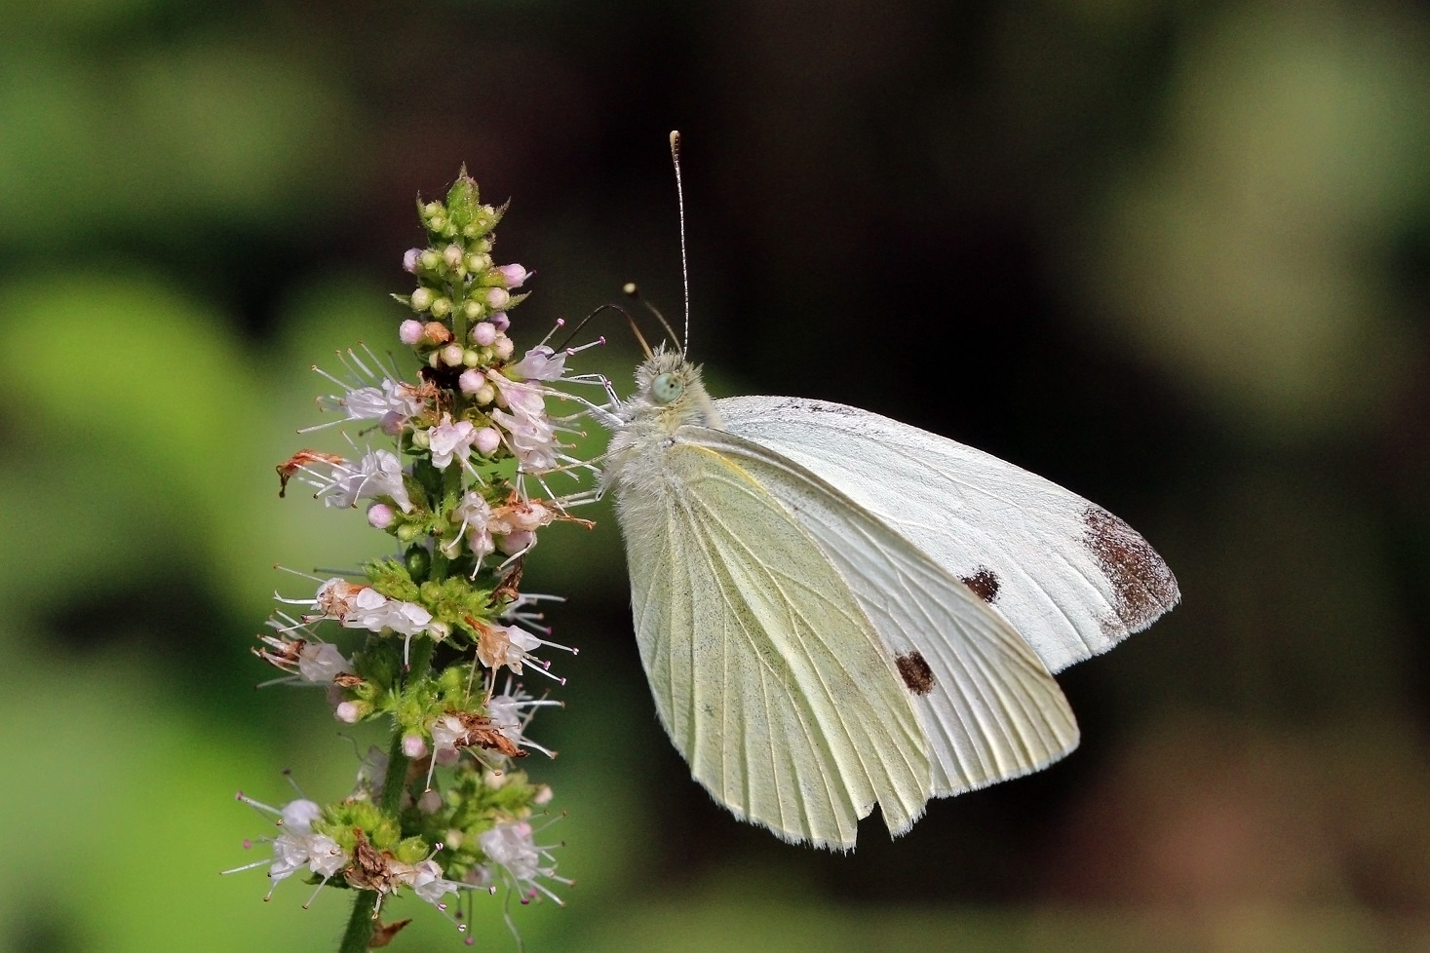
Small white Pieris rapae leucosoma Small to medium-sized Less distinct dark tips and more yellowish on undersides
Attribute: Sharp Photography (Wikipedia Creative Commons)

Slide 24
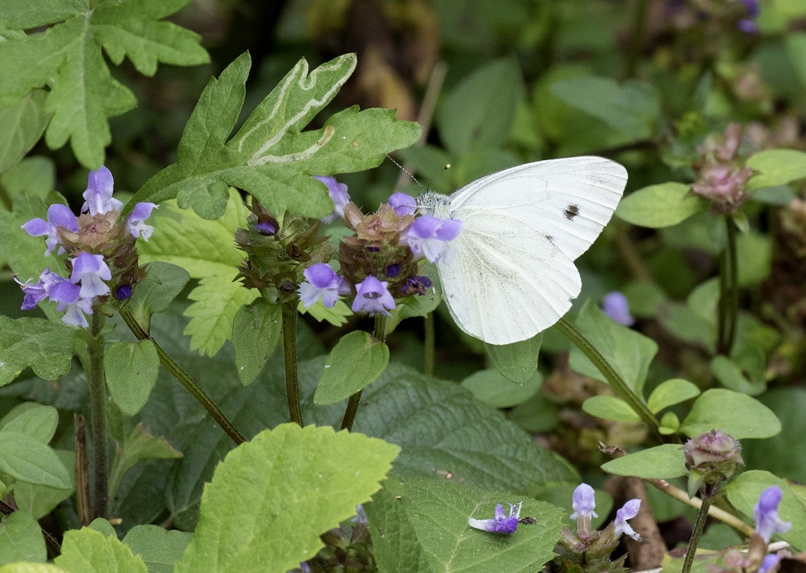
False small white Pieris pseudorapae pseudorapae Small Looks like the small white but with more yellow on wings
Attribute: Zeynel Cebeci (Wikipedia Creative Commons)

Slide 25
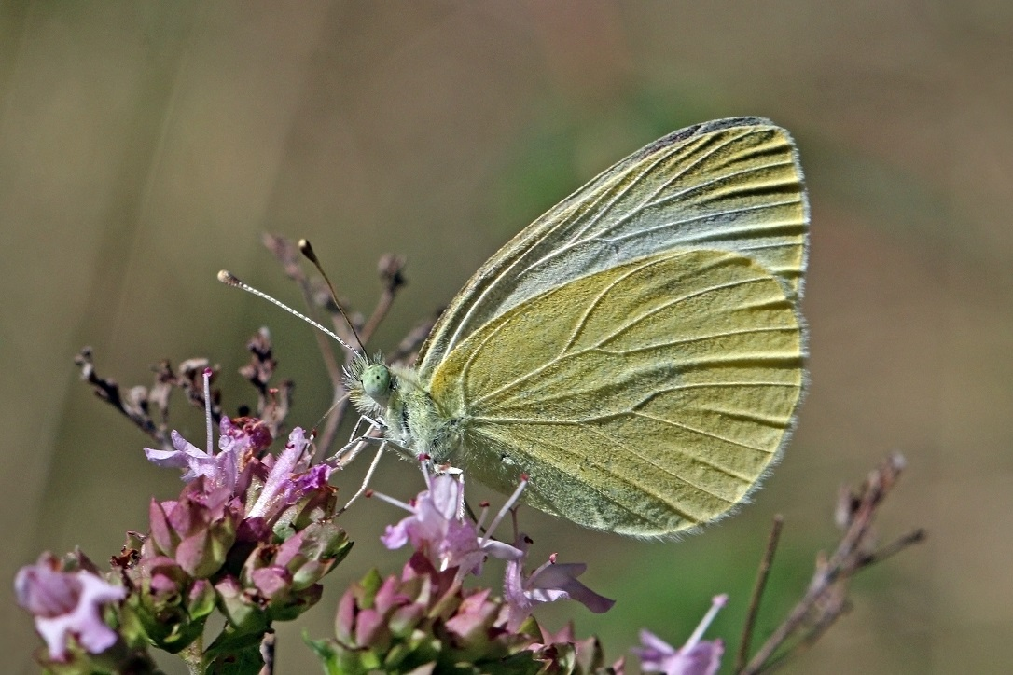
Mountain small white Pieris ergane detersa Small Looks like the small white but with more pointed wings and darker tips
Attribute: Sharp Photography (Wikipedia Creative Commons)

Slide 26
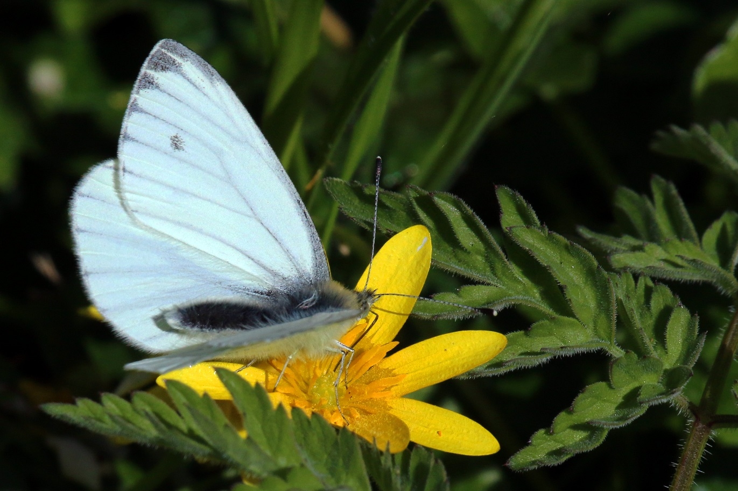
Green-veined white Pieris napi dubiosa Small to medium-sized Looks like the small white but with greenish veins on hindwing undersides
Attribute: Sharp Photography (Wikipedia Creative Commons)

Slide 27
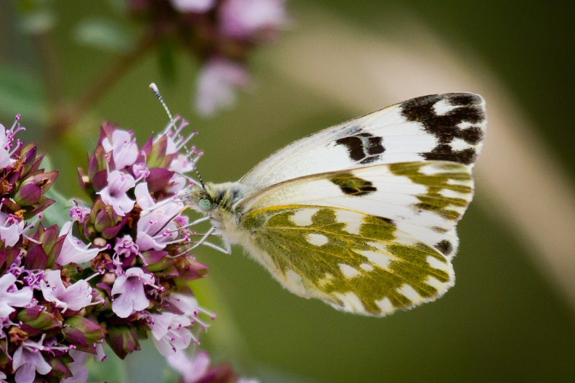
Bath white Pontia daplidice Small to medium-sized White with black and grey wing markings Chequered yellowish-green blotches on the underside
Attribute: Lars Falkdalen Lindahl (Wikipedia Creative Commons)

Slide 28
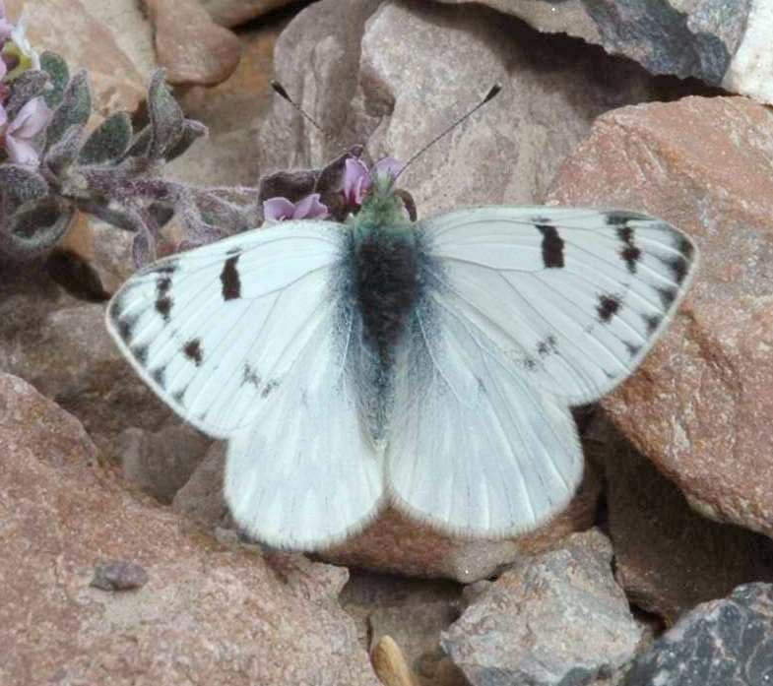
Peak white Pontia callidice chrysidice Small to medium-sized Looks like the Bath white but larger and with less distinct markings

Slide 29
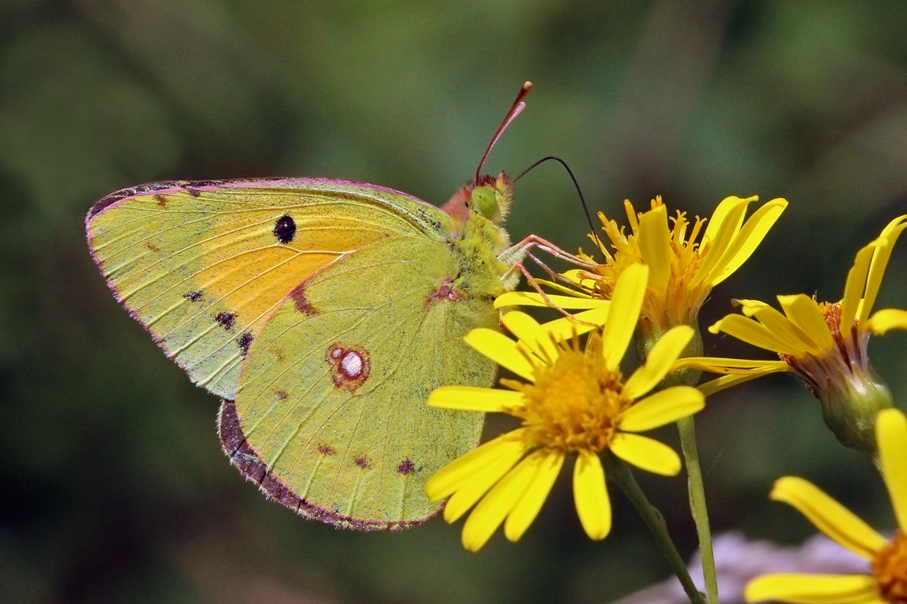
Clouded yellow Colias croceus croceus Medium-sized Distinctly orange-yellow and black Flight very fast
Attribute: Sharp Photography (Wikipedia Creative Commons)

Slide 30
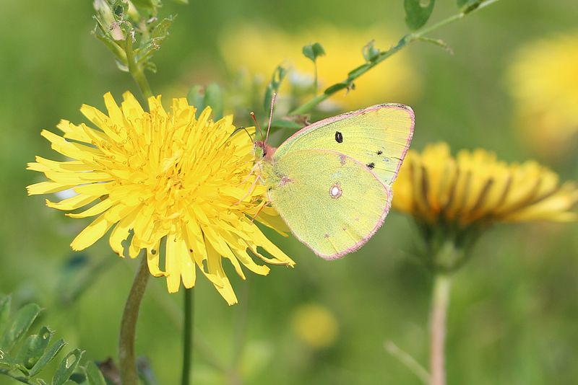
Eastern clouded yellow Colias erate erate Medium-sized Looks like the clouded yellow in shape and markings but lighter yellow in colour
Attribute: Alpsdake (Wikipedia Creative Commons)

Slide 31
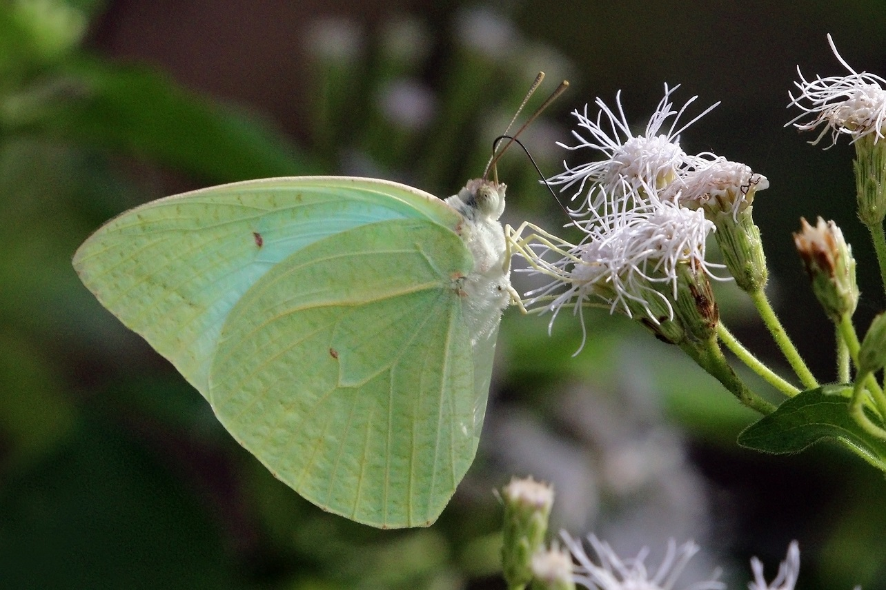
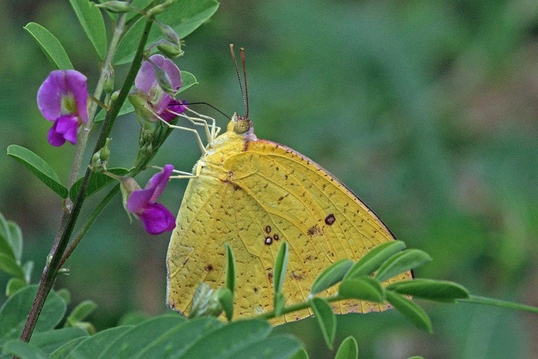
African migrant Catopsilia florella florella Large Looks like the brimstones Males (top) greenish-white with little or no markings Females (bottom) bright yellow or white with black markings
Attribute: Sharp Photography (Wikipedia Creative Commons)

Slide 32
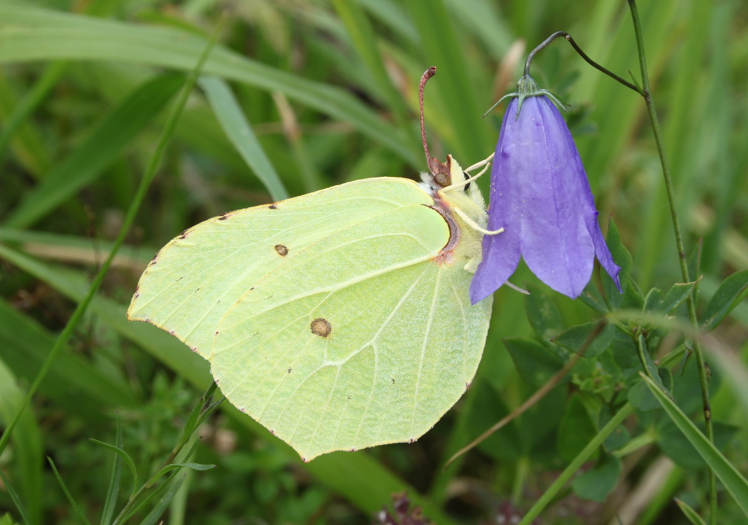
Brimstone Gonepteryx rhamni Large Leaf-shaped wings Males iridescently greenish-yellow Females paler
Attribute: H. Krisp (Wikipedia Creative Commons)

Slide 33
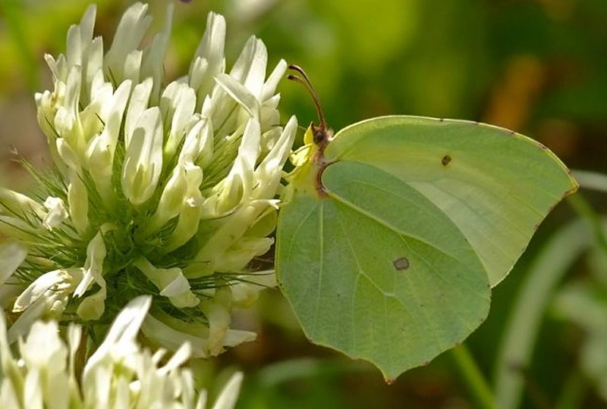
Powdered brimstone Gonepteryx farinosa farinosa Large Looks like the brimstone Males paler yellow Females light bluish-white
Attribute: Mehmet Celik (Wikipedia Creative Commons)

Slide 34
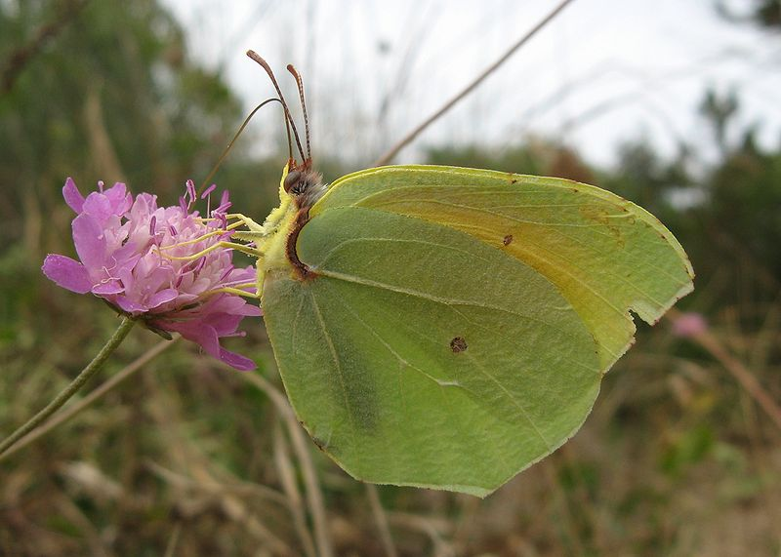
Cleopatra Gonepteryx cleopatra taurica Large Looks like the brimstone Males a deeper yellow colour with orange patches on the forewings Females lighter
Attribute: Rixonrixon (Wikipedia Creative Commons)

Slide 35
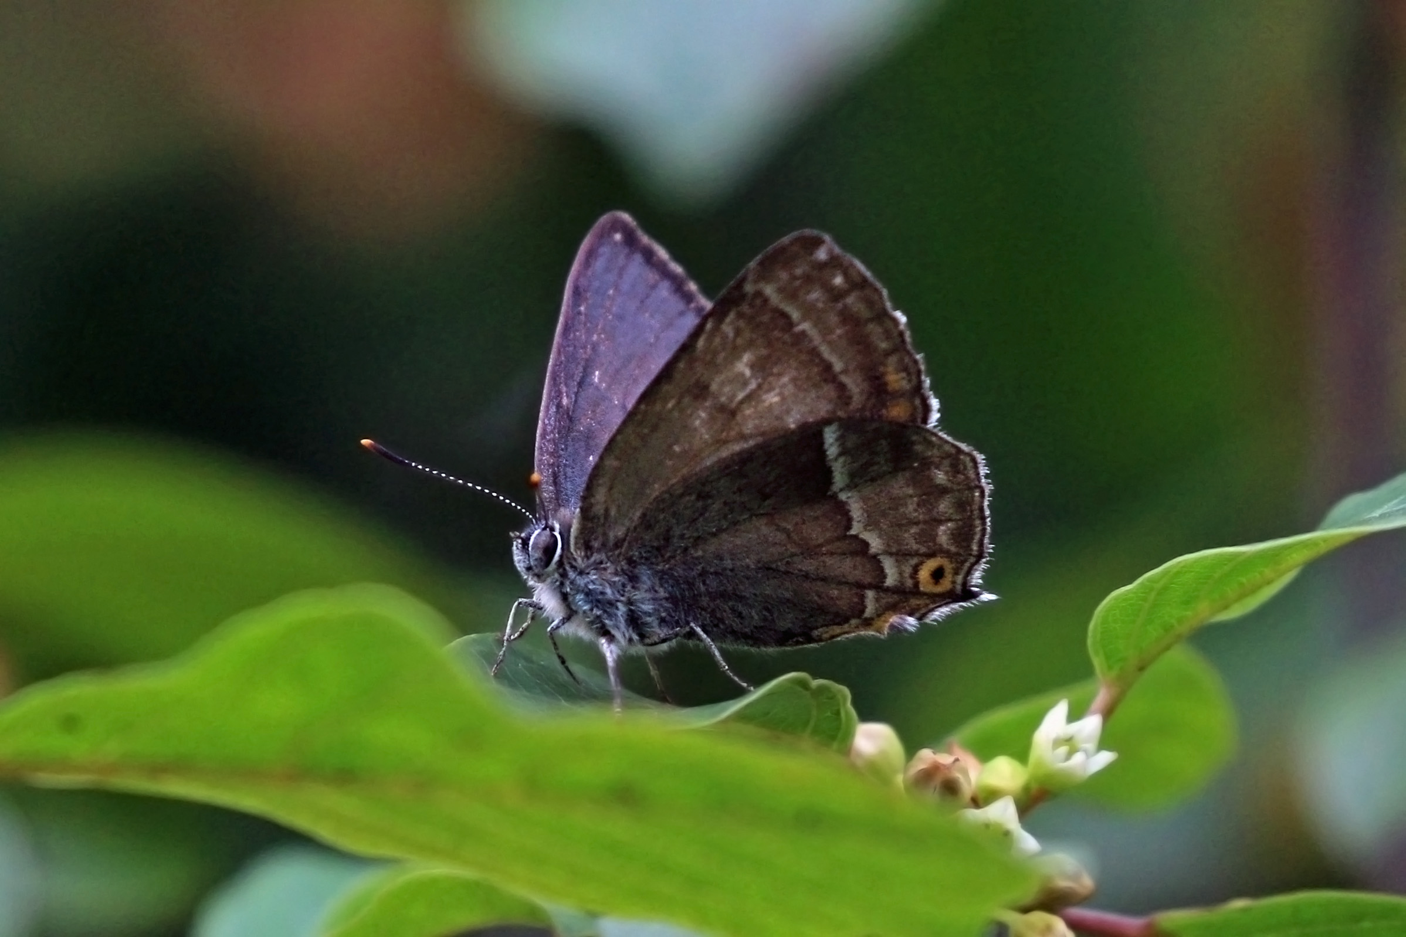
Purple hairstreak Neozephyrus quercus quercus Small Blackish-brown with shiny purple patches Tailed
Attribute: Sharp Photography (Wikipedia Creative Commons)

Slide 36
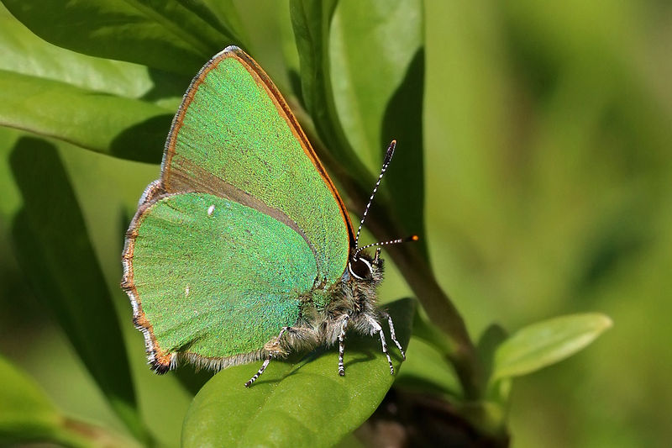
Green hairstreak Callophrys rubi Small Bright green undersides Short trails
Attribute: Sharp Photography (Wikipedia Creative Commons)

Slide 37
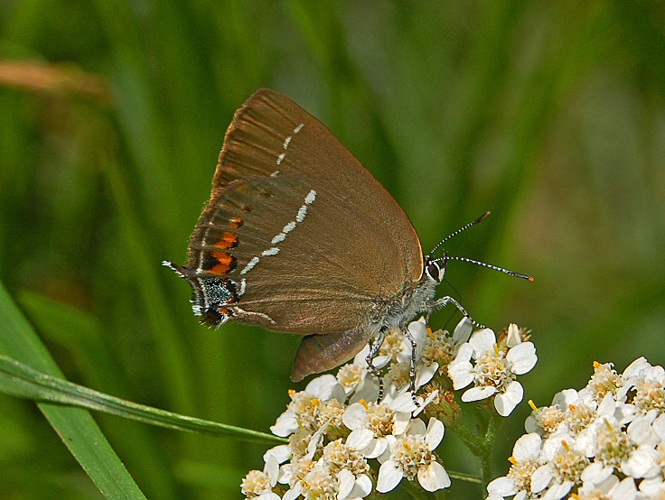
Blue-spot hairstreak Satyrium spini melantho Small Males dark brown with distinct hindwing orange spots Females with forewing orange patches Tailed Flight low and close to the ground
Attribute: Hectonichus (Wikipedia Creative Commons)

Slide 38
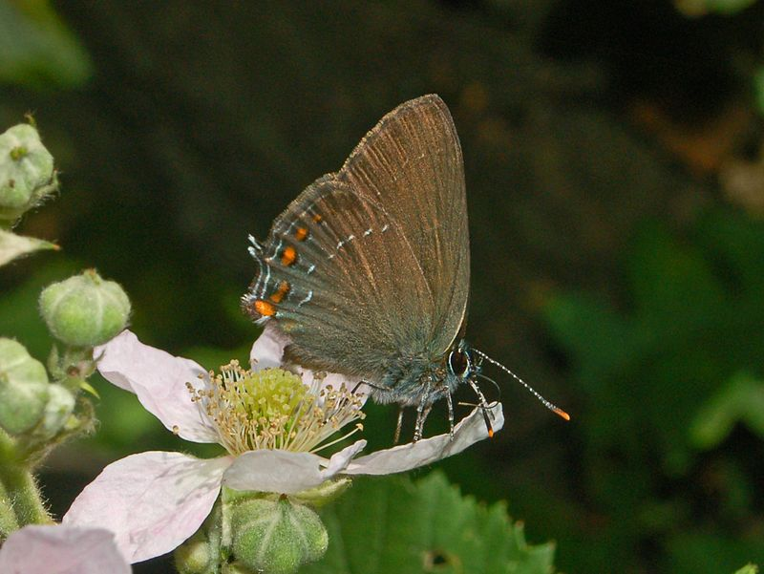
Ilex hairstreak Satyrium ilicis bischoffi Small Looks like the blue-spot hairstreak but with less distinct markings Females with orange spots, not patches as in males Tailed Flight low and close to the ground
Attribute: Hectonichus (Wikipedia Creative Commons)

Slide 39
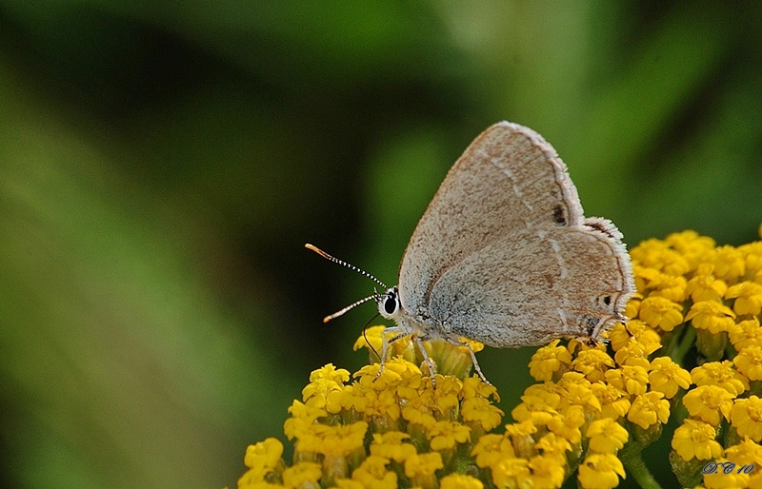
Gerhard's black hairstreak Satyrium abdominalis persica Small Looks like the blue-spot hairstreak but smaller Tailed Flight low and close to the ground
Attribute: Durzan cirano (Wikipedia Creative Commons)

Slide 40
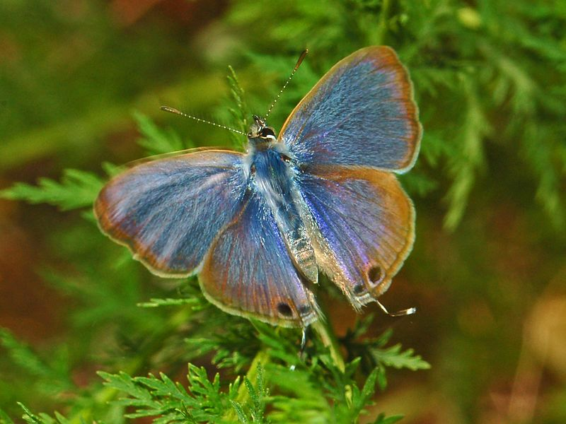
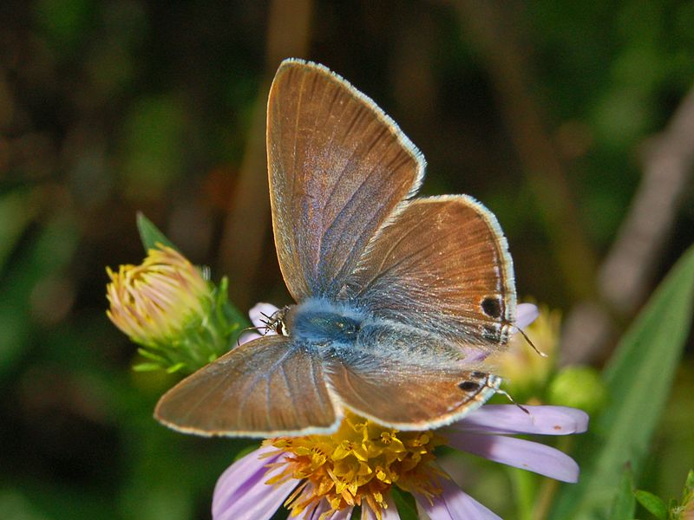
Long-tailed blue Lampides boeticus boeticus Small Females (bottom) larger and dark brownish with some bluish patches Males (top) light violet-blue and look like Lang's short-tailed blue Tailed
Attribute: Hectonichus (Wikipedia Creative Commons)

Slide 41
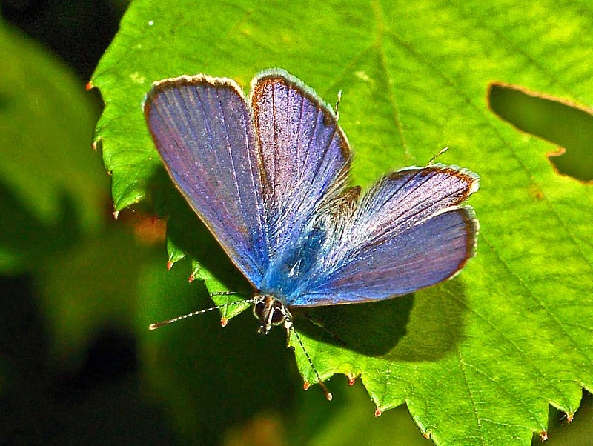
Lang's short-tailed blue Leptotes pirithous pirithous Small Females larger and greyish-brown and blue Males are purplish-blue Short tails
Attribute: Hectonichus (Wikipedia Creative Commons)

Slide 42
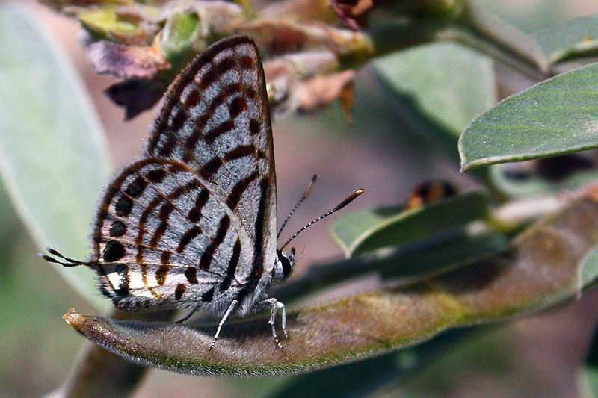
Mediterranean tiger blue Tarucus rosaceus rosaceus Tiny Males lilac blue while females are bluish-brown Tailed Flight is fast, erratic, and close to the ground
Attribute: Sharp Photography (Wikipedia Creative Commons)

Slide 43
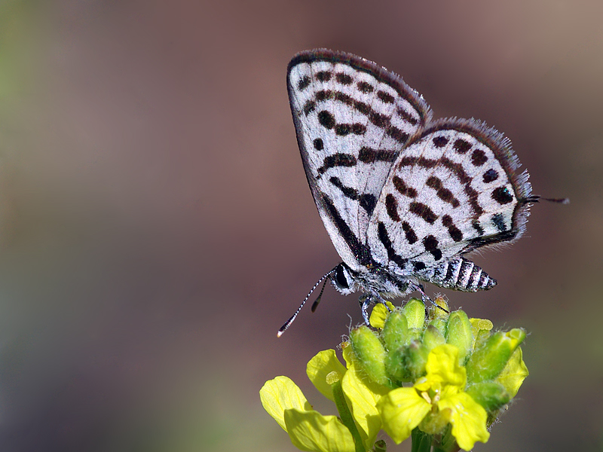
Little tiger blue Tarucus balkanicus balkanicus Tiny Males look like the Mediterranean tiger blue but a brighter blue in colour Tailed Flight is fast, erratic, and close to the ground
Attribute: Zeynel Cebeci (Wikipedia Creative Commons)

Slide 44
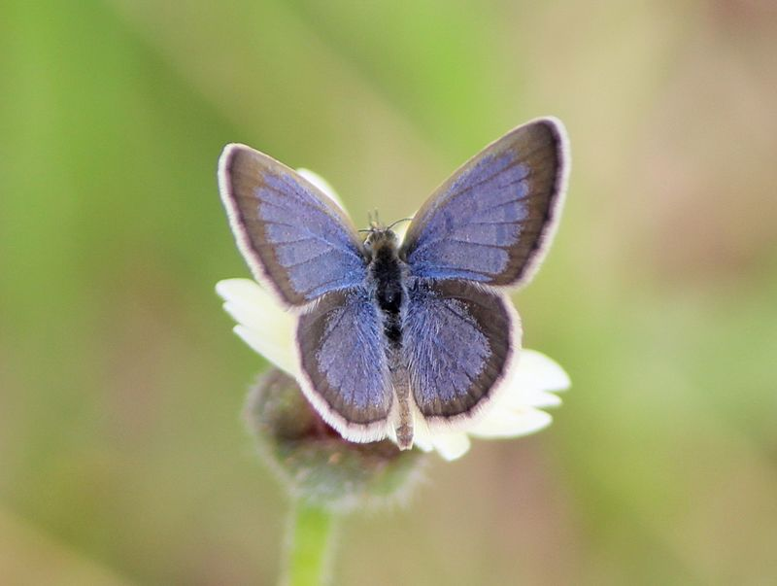
Small mauve blue Zizeeria karsandra karsandra Tiny Males are a lilac-blue with dark brown margins that are wider in females
Attribute: Firos AK (Wikipedia Creative Commons)

Slide 45
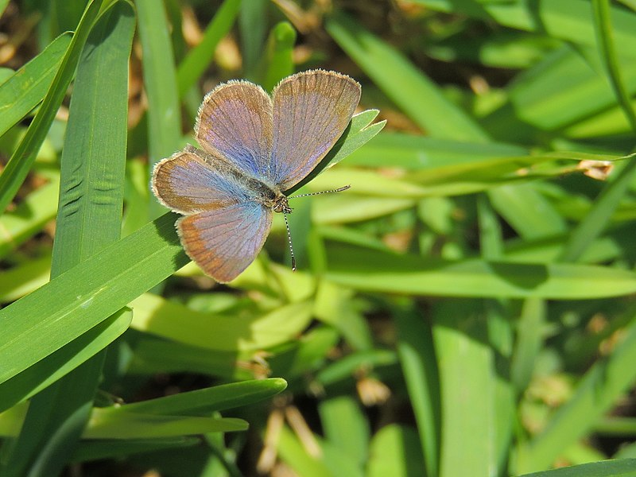
Dark grass blue Zizeeria knysna Tiny Looks like the small mauve blue but has wider black borders Females often larger
Attribute: xulescu_g (Wikipedia Creative Commons)

Slide 46
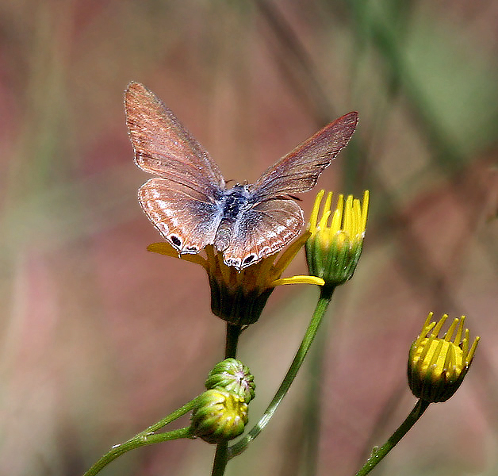
African babul blue Azanus jesous gamra Tiny Females larger and a light bluish-brown Males a pale lilac-blue Short tails
Attribute: J.M. Garg (Wikipedia Creative Commons)

Slide 47
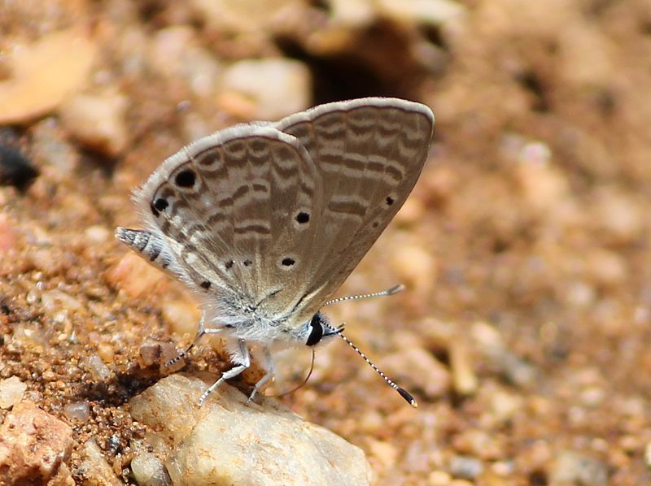
Desert babul blue Azanus ubaldus Tiny Females a silky brown with a bluish-purple tint Males a light blue Short tails
Attribute: Firos AK (Wikipedia Creative Commons)

Slide 48
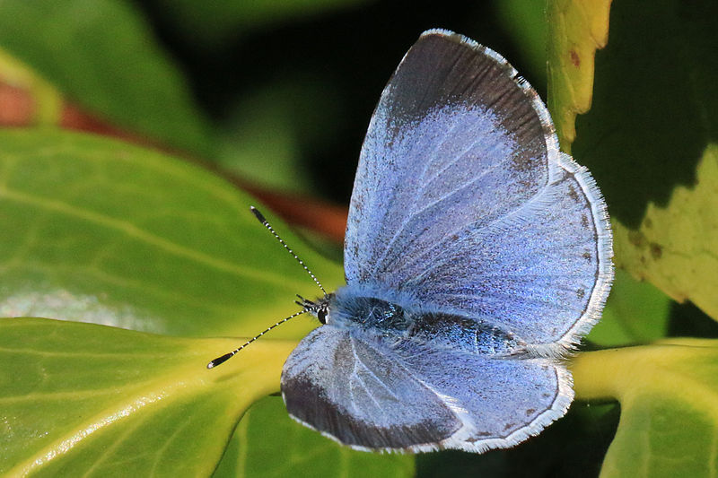
Holly blue Celastrina argiolus paraleuca Tiny Females larger Unmistakable silvery-blue colour
Attribute: Sharp Photography (Wikipedia Creative Commons)

Slide 49
Green-underside blue Glaucopsyche alexis aeruginosa Small Males blue Females brownish Hindwing undersides a shiny green
Attribute: Hectonichus (Wikipedia Creative Commons)

Slide 50
Iolas blue Iolana iolas Small to medium-sized Males violet-blue Females more bluish
Attribute: Jose Manuel Sesma Moranas (Wikipedia Creative Commons)

Slide 51
Chequered blue Pseudophilotes vicrama astabene Tiny Males a light shade of silvery dusky blue Females brownish Chequered fringes
Attribute: Zeynel Cebeci (Wikipedia Creative Commons)

Slide 52
Odd-spot blue Turanana endymion endymion Tiny Males a deep blue with black markings Females bluish-brown
Attribute: Zeynel Cebeci (Wikipedia Creative Commons)

Slide 53
Northern blue Plebejus idas selda Small Males silvery- to violet-blue with thin white and black borders Females greyish-brown
Attribute: Harald Supfle (Wikipedia Creative Commons)

Slide 54
Baldur blue Plebejus baldur Small Looks like the northern blue Males violet-blue with black borders
Attribute: Sharp Photography (Wikipedia Creative Commons)

Slide 55
Silver-studded blue Plebejus argus bellus Small Looks like the northern blue Males bright blue Females a dark brown with orange spots Silver-studded markings on the hindwing
Attribute: Sharp Photography (Wikipedia Creative Commons)

Slide 56
Large jewel blue Plebejus loewii Small Females smaller and brown Males are a bright glossy blue
Attribute: Zeynel Cebeci (Wikipedia Creative Commons)

Slide 57
Eastern brown argus Plebejus carmon euaemon Small Males and females are brownish Crescent-shaped orange-red spots on the wings
Attribute: Sharp Photography (Wikipedia Creative Commons)

Slide 58
Geranium argus Eumedonia eumedon mylitta Small Males and females are brown Rows of orange spots Conspicuous green undersides
Attribute: Janet Graham Photography (Wikipedia Creative Commons)

Slide 59
Brown argus Aricia agestis Small Males and females are brown Orange or orange-red spots
Attribute: Sharp Photography (Wikipedia Creative Commons)

Slide 60
Taurus blue Aricia isaurica Tiny Males emerald-green Wide black borders
Attribute: Zeynel Cebeci (Wikipedia Creative Commons)

Slide 61
Steely argus Aricia crassipuncta Small Males and females are different shades of brown Orange or orange-red spots
Attribute: Zeynel Cebeci (Wikipedia Creative Commons)

Slide 62
Common blue Polyommatus icarus Small to medium-sized Males are a lilac-blue with narrow black margins Females are blue or brown Orange crescent-shaped markings
Attribute: Sharp Photography (Wikipedia Creative Commons)

Slide 63
Chapman's blue Polyommatus thersites gravesi Small Looks like the common blue but males are a brighter violet-blue and lack spots on the forewing undersides
Attribute: Sharp Photography (Wikipedia Creative Commons)

Slide 64
Mazarine blue Polyommatus semiargus semiargus Small Females larger and brown Males a deep violet-blue White wing fringes
Attribute: Sharp Photography (Wikipedia Creative Commons)

Slide 65
Eastern mazarine blue Polyommatus bellis antiochena Small to medium-sized Looks like the mazarine blue but larger Males a lighter blue
Attribute: Zeynel Cebeci (Wikipedia Creative Commons)

Slide 66
Amanda's blue Polyommatus amandus brenda Small to medium-sized Males a glossy sky or silvery-blue with darker margins Females can be blue or brown with a greenish-blue sheen
Attribute: Zeynel Cebeci (Wikipedia Creative Commons)

Slide 67
Lebanese Adonis blue Polyommatus syriacus syriacus Small Males a sky blue with violet patches Females brown with orange crescent-shaped markings
Attribute: Zeynel Cebeci (Wikipedia Creative Commons)

Slide 68
Poseidon blue Polyommatus poseidon mesopotamica Small Males a pale silvery-blue with white fringes White streak on the undersides
Attribute: Zeynel Cebeci (Wikipedia Creative Commons)

Slide 69
Zerny's anomalous blue Polyommatus alcestis alcestis Small Males are dark brown White streak on the underside
Attribute: Zeynel Cebeci (Wikipedia Creative Commons)

Slide 70
Meleager's blue Polyommatus daphnis Small to medium-sized Scalloped hindwings Males a shiny blue Females variable
Attribute: AnneSorbes (Wikipedia Creative Commons)

Slide 71
Grass jewel Chilades trochylus trochylus Tiny Males and females both brown Large orange markings Flight slow, halting, and very close to the ground
Attribute: Zeynel Cebeci (Wikipedia Creative Commons)

Slide 72
Small desert blue Chilades galba galba Tiny Looks like the grass jewel but larger Males blue with reduced orange markings
Attribute: Zeynel Cebeci (Wikipedia Creative Commons)

Slide 73
Small copper Lycaena phlaeas timeus Small Males a distinct golden-orange or shiny tin-coppery colour Dark brown margins and many black dots Short tails
Attribute: Sharp Photography (Wikipedia Creative Commons)

Slide 74
Golden copper Lycaena ochimus ochimus Small Males a shiny golden-copper Females a deeper colour with many black markings Short tails
Attribute: Zeynel Cebeci (Wikipedia Creative Commons)

Slide 75
Fiery copper Lycaena thetis zahaltensis Small Males a bright copper-red Females have black markings and longer tails Yellowish undersides Short tails
Attribute: Zeynel Cebeci (Wikipedia Creative Commons)

Slide 76
Lesser fiery copper Lycaena thersamon omphale Small Males copper-orange and lack markings on the forewings Females have many black dots Short tails
Attribute: Zeynel Cebeci (Wikipedia Creative Commons)

Slide 77
Sooty copper Lycaena tityrus Small Males distinctly dark brown to black Females are coppery and brown Short tails
Attribute: Gilles San Martin (Wikipedia Creative Commons)

Slide 78
Turkish vernal copper Tomares nogelii aurantiaca Small Dark blackish-brown wings Orange patches
Attribute: Zeynel Cebeci (Wikipedia Creative Commons)

Slide 79
Syrian vernal copper Tomares nesimachus nesimachus Small Looks like the Turkish vernal copper but with more orange on its wings
Attribute: Zeynel Cebeci (Wikipedia Creative Commons)

Slide 80
Plain tiger Danaus chrysippus chrysippus Large Conspicuous Orange, black, and white wings White and black dots
Attribute: Jeevan Jose (Wikipedia Creative Commons)

Slide 81
False plain tiger Hypolimnas misippus misippus Large Females larger and look like the plain tiger Males are brownish-black and white
Attribute: Uajith (Wikipedia Creative Commons)
Attribute: Ajith U (Wikipedia Creative Commons)

Slide 82
Southern white admiral Limenitis reducta Large Brownish-black and white with a metallic blue sheen Orange-red on the undersides
Attribute: Sharp Photography (Wikipedia Creative Commons)

Slide 83
Yellow pansy Junonia hierta cebrene Medium-sized to large Bright yellow, brownish-black, and blue wings
Attribute: Sharp Photography (Wikipedia Creative Commons)

Slide 84
Large tortoiseshell Nymphalis polychloros polychloros Large Dark orange with darker borders Many black, yellow, and blue crescent-shaped markings
Attribute: Hectonichus (Wikipedia Creative Commons)

Slide 85
Small tortoiseshell Aglais urticae turcica Medium-sized to large Looks like the large tortoiseshell but more reddish-orange Black markings on hindwings
Attribute: Bohringer Friedrich (Wikipedia Creative Commons)

Slide 86
Red admiral Vanessa atalanta atalanta Large Unmistakable black, red, and white Flight is high and purposeful
Attribute: Luc Viatour (Wikipedia Creative Commons)

Slide 87
Painted lady Vanessa cardui cardui Large Reddish-orange, pink, blackish-brown, and white Flight is strong and often seen perching on the ground

Slide 88
Comma Polygonia c-album c-album Medium-sized to large Looks like the large tortoiseshell in colour Deeply dentated and notched wings
Attribute: Sharp Photography (Wikipedia Creative Commons)

Slide 89
Cardinal Argynnis pandora pandora Large Greenish-orange colour Females larger and brighter Forewings slightly concave Dark green undersides
Attribute: Jorg Hempel (Wikipedia Creative Commons)

Slide 90
Niobe fritillary Argynnis niobe Medium-sized to large Males bright brown-orange Females are larger and duller with darker markings Greenish undersides like the cardinal
Attribute: Zeynel Cebeci (Wikipedia Creative Commons)

Slide 91
Queen of Spain fritillary Issoria lathonia lathonia Medium-sized Males and females a bright orange-violet Many brownish-black markings Pearly spots on the undersides
Attribute: Folkets Korall (Wikipedia Creative Commons)

Slide 92
Knapweed fritillary Melitaea phoebe Medium-sized Bright orange-red colour Many black markings
Attribute: Bernard Dupont (Wikipedia Creative Commons)

Slide 93
Punic fritillary Melitaea punica telona Small Looks like the knapweed fritillary but smaller and of a lighter yellowish colour
Attribute: Zeynel Cebeci (Wikipedia Creative Commons)

Slide 94
Lederer's fritillary Melitaea collina collina Small to medium-sized Looks like the knapweed fritillary but smaller
Attribute: Zeynel Cebeci (Wikipedia Creative Commons)

Slide 95
Toadflax fritillary Melitaea didyma Medium-sized Bright reddish-orange colour Many black markings Females larger and duller
Attribute: Sharp Photography (Wikipedia Creative Commons)

Slide 96
Desert fritillary Melitaea deserticola deserticola Small to medium-sized Looks like the toadflax fritillary but with different black markings on the undersides
Attribute: Husein Zorkot

Slide 97
Glanville fritillary Melitaea cinxia clarissa Medium-sized Females larger and sandy or greyish-brown Males orange-red Black lines and spots
Attribute: Gilles San Martin (Wikipedia Creative Commons)

Slide 98
Two-tailed pasha Charaxes jasius jasius Large Females larger Dark brown and orange-yellow Dentated hindwings Short tails
Attribute: Hectonichus (Wikipedia Creative Commons)

Slide 99
Levantine marbled white Melanargia titea Large White and black wings Wide black borders with white dots
Attribute: Zeynel Cebeci (Wikipedia Creative Commons)

Slide 100
Freyer's grayling Hipparchia fatua sichaea Small Dark brown colour Eyespots Females are lighter
Attribute: Zeynel Cebeci (Wikipedia Creative Commons)

Slide 101
Great steppe grayling Chazara persephone transiens Medium-sized to large Contrasting dark brown and white wing patterns Black spots
Attribute: Zeynel Cebeci (Wikipedia Creative Commons)

Slide 102
Klug's tawny rock brown Pseudochazara pelopea pelopea Large Dark brown colour Orange-red bands
Attribute: Zeynel Cebeci (Wikipedia Creative Commons)

Slide 103
Great sooty satyr Satyrus ferula makmal Large Males dark blackish-brown Females lighter with orange-red bands Distinct eyespots
Attribute: Wilma van Holten(Wikipedia Creative Commons)

Slide 104
Dusky meadow brown Hyponephele lycaon libanotica Medium-sized to large Males dark brown Females a lighter chestnut colour Distinct eyespots
Attribute: Sharp Photography (Wikipedia Creative Commons)

Slide 105
Oriental meadow brown Hyponephele lupina Medium-sized Looks like the dusky meadow brown but larger Dark golden-brown and orange-red colour Females paler with more distinct eyespots
Attribute: Zeynel Cebeci (Wikipedia Creative Commons)

Slide 106
Eastern meadow brown Maniola telmessia telmessia Medium-sized Males dark brown with yellowish-orange bands on the forewings Females lighter with more orange on wings
Attribute: Zeynel Cebeci (Wikipedia Creative Commons)

Slide 107
Small heath Coenonympha pamphilus neolyllus Small Soft yellowish-orange Females larger with a pair of eyespots on the front wings
Attribute: Quartl (Wikipedia Creative Commons)

Slide 108
Wall brown Lasiommata megera Medium-sized to large Females larger and lighter Light brown colour with paler yellow-orange bands Eyespots
Attribute: Sharp Photography (Wikipedia Creative Commons)

Slide 109
Large wall brown Lasiommata maera orientalis Large Darker than the wall brown Dark brown with reddish-orange bands
Attribute: Harald Supfle (Wikipedia Creative Commons)

Slide 110
Speckled wood Pararge aegeria aegeria Medium-sized to large Females often larger Dark brown and golden-orange wings Distinct eyespots
Attribute: Sharp Photography (Wikipedia Creative Commons)

Slide 111
African ringlet Ypthima asterope asterope Small Brownish-grey or slate Unmistakable eyespots, one on each wing Flight slow and "bobbing" close to ground
Attribute: Zeynel Cebeci (Wikipedia Creative Commons)

Slide 112
Hollyhock skipper Carcharodus alceae alceae Small Dark brown and reddish-pink with a purplish to olive-green sheen
Attribute: Entomart (Wikipedia Creative Commons)

Slide 113
Oriental skipper Carcharodus orientalis maccabaeus Small Distinctly bluish-grey wings
Attribute: Zeynel Cebeci (Wikipedia Creative Commons)

Slide 114
Inky skipper Erynnis marloyi marloyi Small Females larger Dark brown Black spots and stripes on the forewings
Attribute: Zeynel Cebeci (Wikipedia Creative Commons)

Slide 115
Large grizzled skipper Muschampia proto Small Greyish-brown to nearly black with creamy markings Flight is fast
Attribute: gailhampshire (Wikipedia Creative Commons)

Slide 116
Tessellated skipper Muschampia tessellum cribrelloides Small Looks like the large grizzled skipper but larger Darker brown colour without the greenish tinge Whiter markings
Attribute: Zeynel Cebeci (Wikipedia Creative Commons)

Slide 117
Anatolian skipper Muschampia proteides proteides Small Light brown colour Creamy-grey spots
Attribute: Zeynel Cebeci (Wikipedia Creative Commons)

Slide 118
Oberthur's grizzled skipper Pyrgus armoricanus philonides Small Golden-brown colour but darker than other species Reduced forewing white markings Pale reddish-brown undersides
Attribute: Katya (Wikipedia Creative Commons)

Slide 119
Olive skipper Pyrgus serratulae alveoides Small Looks like the Oberthur's grizzled skipper but larger and of a darker brown colour Tiny white markings Reddish-brown and olive-green undersides
Attribute: Martin Bjerg (Wikipedia Creative Commons)

Slide 120
Levantine grizzled skipper Pyrgus melotis melotis Small Larger and lighter than other skippers Large creamy-white spots on the undersides
Attribute: Zeynel Cebeci (Wikipedia Creative Commons)

Slide 121
Orbiferous skipper Spialia orbifer hilaris Small Dark brown colour Prominent white markings
Attribute: Zeynel Cebeci (Wikipedia Creative Commons)

Slide 122
Kiki's skipper Spialia phlomidis Small Dark brown in colouration Looks like the orbiferous skipper but has smaller white spots and a continuous white band on the hindwing undersides
Attribute: Zeynel Cebeci (Wikipedia Creative Commons)

Slide 123
Zeller's skipper Borbo borbonica zelleri Small Light to dark brown White dots on the forewings Pointed forewings Flight fast and close to the ground
Attribute: Sharp Photography (Wikipedia Creative Commons)

Slide 124
Pigmy skipper Gegenes pumilio pumilio Small Pointed forewings Males are a darker brown Females have a number of white spots Flight is fast, powerful, and close to the ground
Attribute: Sharp Photography (Wikipedia Creative Commons)

Slide 125
Peaty skipper Gegenes nostrodamus nostrodamus Small Looks like the pigmy skipper but larger and lighter Dark brown colour Females lighter with white spots Flight quick and close to the ground

Slide 126
Silver-spotted skipper Hesperia comma pallida Small Light orange-brown with many blue, yellow, and white markings, especially on the undersides Pointed forewings Hindwings are slightly concave
Attribute: Svdmolen (Wikipedia Creative Commons)

Slide 127
Lulworth skipper Thymelicus acteon phoenix Small Females larger with golden "sunray" areas on the forewings Orange-brown with no markings Flight is fast, darting, and whirling
Attribute: Sharp Photography (Wikipedia Creative Commons)

Slide 128
Small skipper Thymelicus sylvestris syriacus Small Bright reddish-orange colour Larger than other species with less distinct veins
Attribute: Aiwok (Wikipedia Creative Commons)

Slide 129
European skipper Thymelicus lineola melissus Small Looks like the small skipper but smaller Distinct black borders and veins Yellowish undersides in males, greyish in females
Attribute: Sharp Photography (Wikipedia Creative Commons)

Slide 130
Levantine skipper Thymelicus hyrax hyrax Small Light orange-red Distinct orange patches on the forewings Greenish hindwing undersides
Attribute: Zeynel Cebeci (Wikipedia Creative Commons)

Slide 131
Millet skipper Pelopidas thrax thrax Small Looks like the peaty and pigmy skippers but larger Hooked antennae Yellow spots on the forewings Pointed forewings Flight is fast, active, and close to the ground
Attribute: Zeynel Cebeci (Wikipedia Creative Commons)

Slide 132
Large skipper Ochlodes sylvanus faunus Small to medium-sized Brownish orange-red Greenish-yellow undersides Flight is fast and whirling
Attribute: Andreas Eichler (Wikipedia Creative Commons)

Slide 133
Butterfly Sizes Tiny <25 mm Small 25-35 mm Medium-sized 35-50 mm Large >50 mm
Attribute: Sharp Photography (Wikipedia Creative Commons)

Slide 134
THANK YOU Questions or concerns? Please reach developer: Husein Zorkot Lepidopterist, Butterfly Gardener, Conservationist, and BG & P Manager Email: huseinspnl@gmail.com Mobile: 76 371 382 Please visit our website, Butterflies and Moths of Lebanon LEPIDOPTERA LIBANOTICA, at http://butterflies.spnl.org/
Prepared by Husein Zorkot
FOXFIRE Environmental Education, SPNL

