Slide 1
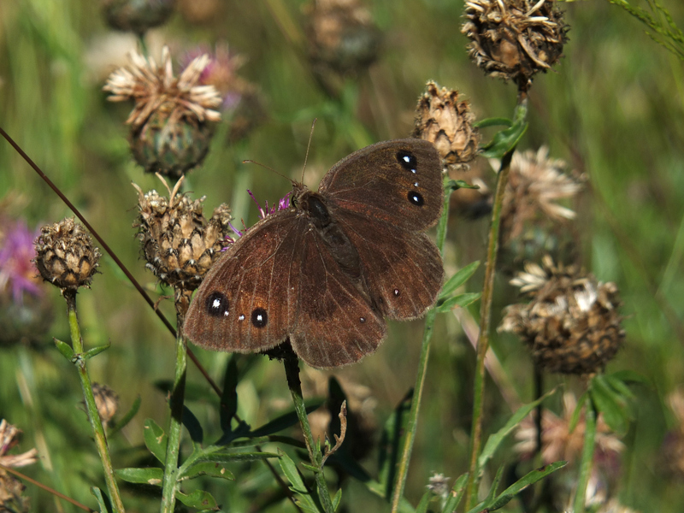
BUTTERFLY MONITORING principles and methodology
Husein Zorkot
HHI Park Butterfly Garden & Pavilion
Field Manager/Butterfly Expert & Lepidopterist
Lebanon Butterfly Monitoring Scheme (LBMS)
Butterflies and Moths of Lebanon LEPIDOPTERA LIBANOTICA
Attribute: Wilma van Holten (Wikipedia Creative Commons)

Slide 2
LEBANON BUTTERFLY MONITORING SCHEME (lbms)
Founded in 2018 by Husein A. Zorkot
First butterfly monitoring program in Lebanon
Conducts long-term biomonitoring studies
Monitors butterflies (plus moths, dragonflies, and other insects) in all nature reserves and hima locations around the country
Determines the extent of environmental threats and climatic factors effecting butterfly populations
Identifies prime butterfly areas (PBAs) and key biodiversity areas (KBAs)
Guides butterfly conservation in Lebanon
Now an integrated SPNL initiative

Slide 3
BUTTERFLIES OF LEBANON: the big picture
Diverse butterfly fauna compared to its land size
Unique location between Asia, Africa, and Europe, in the Eastern Mediterranean region
165 species of butterflies, a number much higher than that of nearly every other country in the Middle East and North Africa, and many countries in Europe
Anywhere from 600-800 species of moths, 50 plus species of dragonflies
20 plus threatened and near threatened species of butterflies
45 endemics and near-endemics
Many isolated alpine species, a result of numerous glacial refugia
A large number of eremics, increasing due to global warming
Many migratory species, i.e. on the route of butterfly migration, Lebanon a source, transit stop, and destination

Slide 4
THREATS
Habitat loss
Habitat degradation
Urbanisation
Agricultural expansion and irresponsible farming
Use of agrochemicals (pesticides and herbicides)
Pollution
Invasive species
Overcollection of host plants
Genetically-modified organisms (GMOs)
Hybridisation
Climate change and global warming
Desertification
Uncontrolled tree felling
Forest fires
Erosion
Overgrazing
Quarrying and excessive mining activity
Butterfly collecting
Wars
Poverty
Ignorance and lack of public awareness

Slide 5
Butterflies as Bioindicators
Butterflies are considered valuable bioindicators because they:
have short lifespans
rely on particular plant species, “host plants,” during their development
play a very crucial role in pollination and the health of ecosystems
are more sensitive to environmental change than other groups of animals
reflect changes occurring at a fine scale, breeding even in small habitat patches
represent a wide range of terrestrial habitats
are well-documented
are easy to recognise
are popular with people

Slide 6
Butterflies as Bioindicators
Studies on grassland butterflies have shown that their numbers have decreased dramatically over recent decades
The main causes are thought to be agricultural intensification and grassland abandonment
Agricultural intensification entails a broad range of activities, such as:
the conversion of untended pastures to arable crops and permanent grasslands into temporary ones
the heavy use of agrochemicals such as fertilisers, herbicides, insecticides, and pesticides
drainage
the expansion of fields
the removal of field margins and important landscape features
the use of heavy machinery
Often, the remaining agricultural land becomes nearly devoid of butterflies. In these places, butterflies can often only survive on the margins of roads and dirt paths, in isolated nature reserves and parks, and in urban areas. However, in these marginal areas, butterflies are still exposed to the hazards of wind-carried insecticides and nitrogen fertilisers that kill many of the larvae near sprayed fields

Slide 7
Butterflies as Bioindicators
Intensification, along with abandonment, is thought to lead to the fragmentation and isolation of remaining patches of grassland. This reduces the chances of survival of local butterfly populations and makes recolonisation very difficult when they become near extinct
Global warming will effect the distribution and population sizes of butterfly species through extreme weather phenomena such as fires and droughts, or will change their composition altogether
Butterflies that are found in alpine habitats will not be able to move to higher altitudes and will be unlikely to find suitable pastures there as temperatures rise
Butterfly species from warm and tropical climates will increase, while other species will migrate to more temperate zones
Thus, butterfly monitoring is necessary to assess large-scale biodiversity trends

Slide 8
BUTTERFLies as bioINDICATORS
Some Lebanese species identified as bioindicators in a number of studies:
Plebejus argus
Azanus jesous
Zizeeria karsandra
Polyommatus daphnis
Polyommatus icarus
Polyommatus semiargus
Hipparchia syriaca
Hipparchia alcyone
Hipparchia fatua
Chazara persephone
Lasiommata maera
Lasiommata megera
Kirinia roxelana
Pararge aegeria
Coenonympha pamphilus
Satyrus ferula
Hyponephele lupinus
Maniola telmessia
Gegenes pumilio
Thymelicus acteon
Thymelicus lineola
Thymelicus sylvestris
Ochlodes sylvanus
Borbo borbonica
Hesperia comma

Slide 9
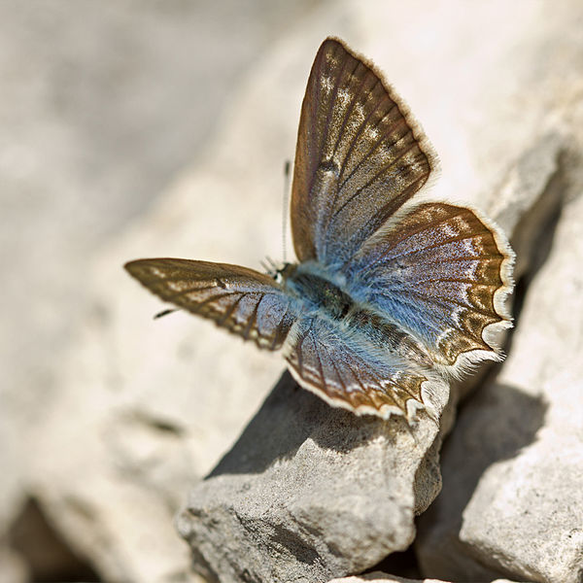
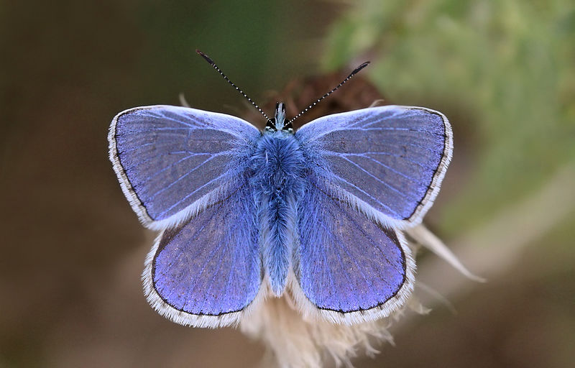
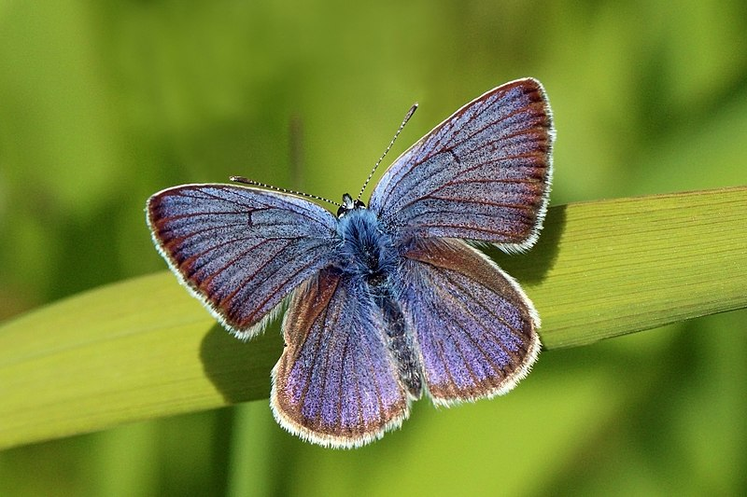
Attribute: Sharp Photography (Wikipedia Creative Commons)
Attribute: AnneSorbes (Wikipedia Creative Commons)
Attribute: Sharp Photography (Wikipedia Creative Commons)
Attribute: Sharp Photography (Wikipedia Creative Commons)

Slide 10
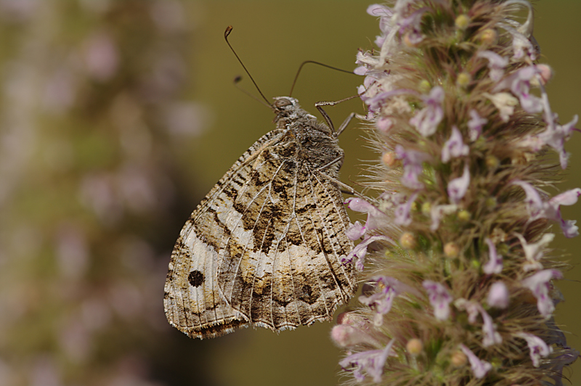
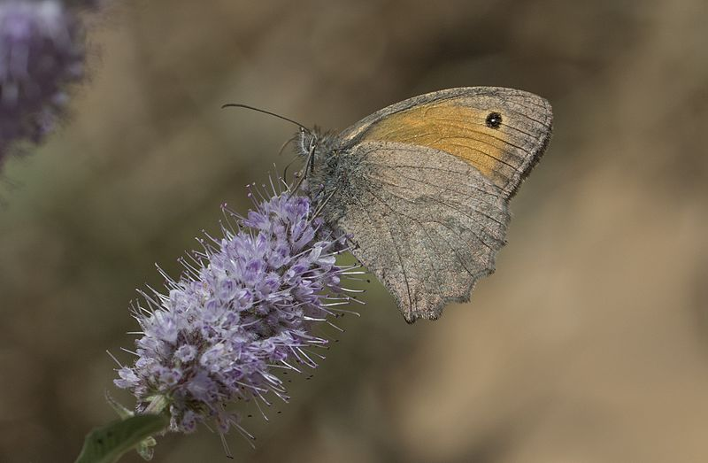
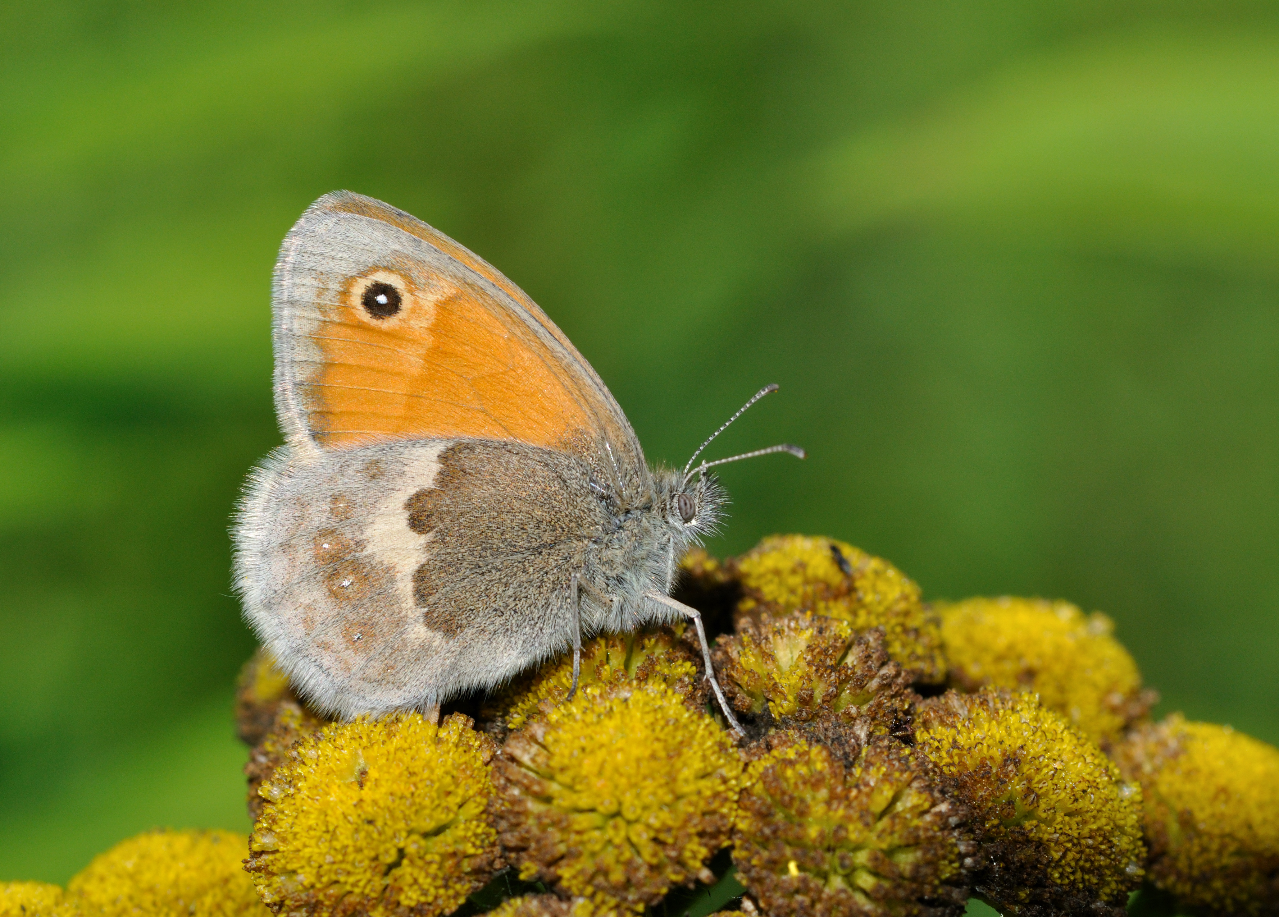
Attribute: Zeynel Cebeci (Wikipedia Creative Commons)
Attribute: Hectonichus (Wikipedia Creative Commons)
Attribute: Quartl (Wikipedia Creative Commons)
Attribute: Zeynel Cebeci (Wikipedia Creative Commons)

Slide 11
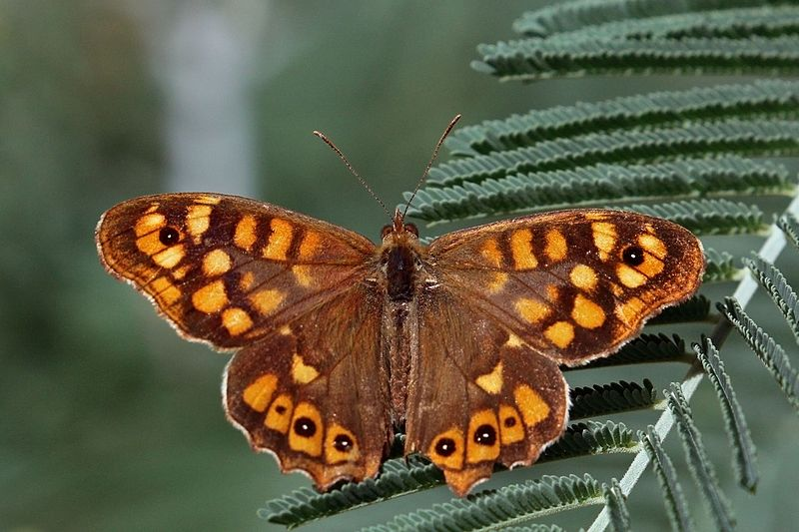
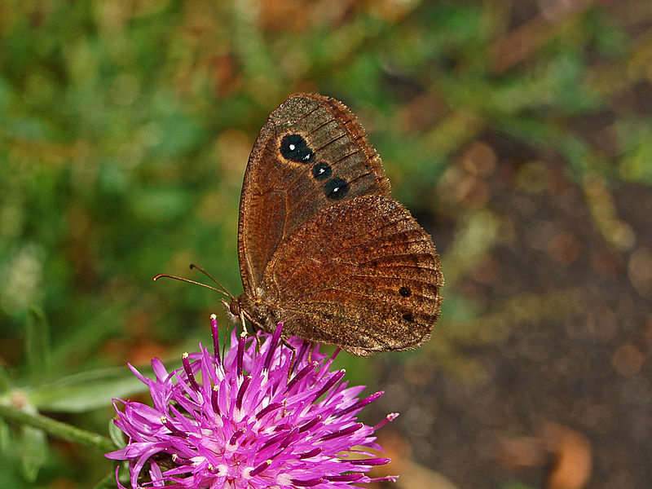
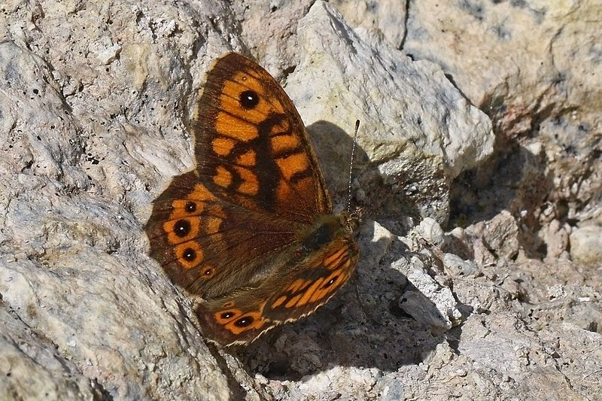
Attribute: Sharp Photography (Wikipedia Creative Commons)
Attribute: Zeynel Cebeci (Wikipedia Creative Commons)
Attribute: Hectonichus (Wikipedia Creative Commons)
Attribute: Sharp Photography (Wikipedia Creative Commons)

Slide 12
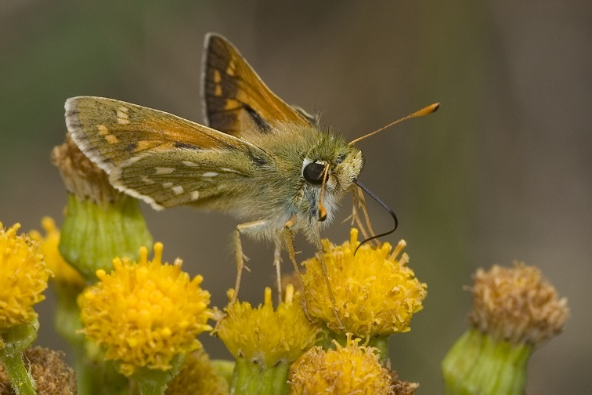
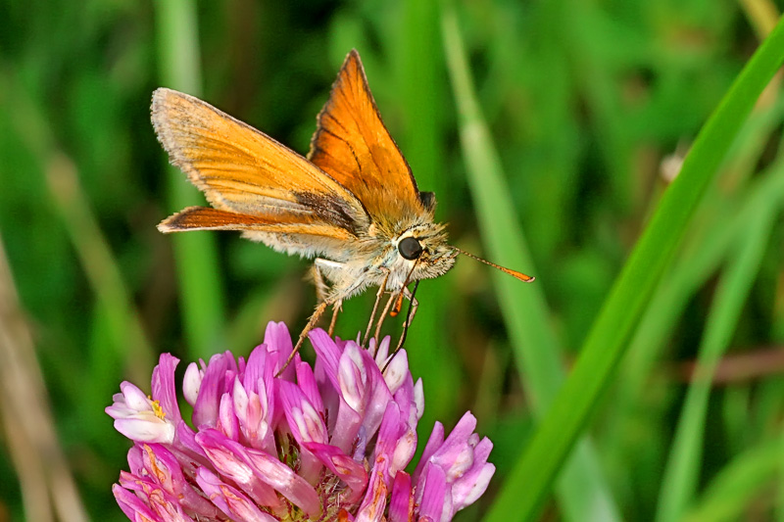
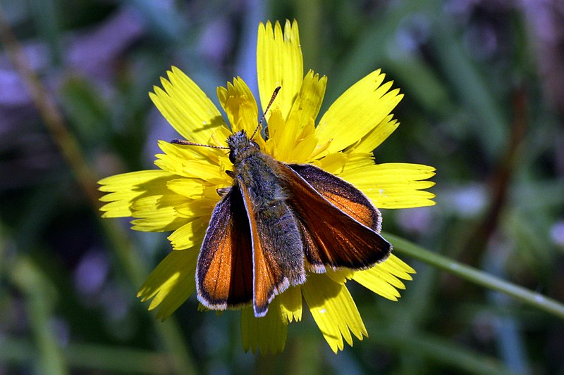
Attribute: Sharp Photography (Wikipedia Creative Commons)
Attribute: Valerius Geng (Wikipedia Creative Commons)
Attribute: Sharp Photography (Wikipedia Creative Commons)
Attribute: Svdmolen (Wikipedia Creative Commons)

Slide 13
Butterflies and Sustainable Practices
Sustainable grazing practices and grassland management have been shown to be correlated with higher biodiversity of plants and butterflies. Traditional modes of farming, such as extensive livestock grazing and haymaking where fertilisers and pesticides are kept to a minimum, provide ideal environments for butterflies
Butterfly gardening, a low maintenance, environment-friendly, sustainable type of gardening, utilises native butterfly plants to attract and maintain the presence of local butterflies. This type of gardening, if applied on a large-scale throughout the country, has tremendous potential for nature conservation

Slide 14
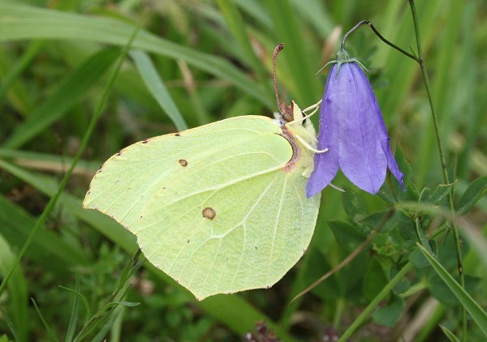
Butterflies IN LEBANON’s NATURE PARKS
An example, the Shouf Biosphere Reserve (ACS)
51 species documented
Nearly a third of the country’s entire butterfly fauna
(n=165)
Attribute: H. Krisp (Wikipedia Creative Commons)

Slide 15
Butterflies IN LEBANON’s NATURE PARKS
Papilio alexanor
Allancastria cerisyi
Allancastria deyrollei
Parnassius mnemosyne
Pieris napi
Pieris ergane
Colias aurorina
Gonepteryx rhamni
Gonepteryx farinosa
Leptidea duponcheli
Argynnis niobe
Issoria lathonia
Melitaea cinxia
Melitaea didyma
Melanargia titea
Hipparchia alcyone
Hipparchia fatua
Pseudochazara telephassa
Pseudochazara pelopea
Satyrus ferula
Hyponephele lycaon
Hyponephele lupinus
Kirinia roxelana
Threatened, near-threatened, rare, or endemic species

Slide 16
Butterflies IN LEBANON’s NATURE PARKS
Callophrys rubi
Satyrium ilicis
Satyrium ledereri
Neozephyrus quercus
Tomares nogelii
Tomares nesimachus
Lycaena phlaeas
Lycaena asabinus
Lycaena ochimus
Lycaena thetis
Plebejus idas
Plebejus pylaon
Eumedonia eumedon
Aricia dorsumstellae
Aricia bassoni
Polyommatus bellis
Polyommatus isauricoides
Polyommatus ellisoni
Polyommatus thersites
Polyommatus syriacus
Glaucopsyche alexis
Turanana endymion
Pyrgus armoricanus
Spialia phlomidis
Carcharodus stauderi
Pelopidas thrax

Slide 17
materials
Clipboard
Writing utensils
Notebook (to jot down details on floristic composition of each transect, butterflies, day moths, dragonflies, bees, ants, other observations, etc.)
Paper (as extra tally sheets when running out of space on the forms)
Outdoor daypack or bag
Butterfly Transect Details and Recording Forms (provided)
Camera (to better identify butterfly species and consult with expert)
Wristwatch (to keep track of time, start/finish times)
Cellular phone (in case of emergency)
Phone internet access (to obtain weather conditions, map coordinates, satellite image of location, databases, online resources, butterfly website, communication, keep track of time, etc.)
Field guides or atlases (A Field Guide to the Butterflies of Lebanon and the Middle East or Butterfly Gardening in Lebanon, call or email SPNL office)
Butterfly Field Identification Sheets (provided)
Portable thermometer (note: other weather conditions, such as percent sunshine, wind direction and speed, can be obtained manually as approximations)
Map of biosphere or local area
Solar-powered calculator
Tape measure
String
First aid kit
Boots or protective footwear
Appropriate long-sleeved clothing and trousers (protection from thorny plants and animal bites)
Hat or cap (protection from sun’s rays)
Water and food (to keep hydrated and energised during long hot days)
A quick, reliable method of transportation

Slide 18
BUTTERFLY TRANSECT DETAILS FORM
Includes:
Transect Name
Transect Code
Map Coordinates
Province/District
Year Transect Established
Transect Length (m)
Transect Width (m)
Overall Habitat Description (Vegetation Type/Land Cover)
Habitat Code(s)
Land Use Type
Land Conservation Status
Type of Recorder
Recorder Details
Land Tenure Details
Transect Map
Field Notes & Observations
Section Details (Section Number, Coordinates, Length (m), Habitat(s), and Management)

Slide 19
BUTTERFLY TRANSECT RECORDING FORM
Includes:
Transect Name
Recorder
Year
Date
Week No.
Start Time
Finish Time
Average Temp. (°C)
Average Wind Speed (0-6) (note: determined manually from the Beaufort Scale)
Wind Direction
Butterfly Species (no. of individuals of each species, in each section)
% Sunshine (and Average Sunshine, note: determined from the formula on the second page)
Field Notes & Additional Species

Slide 20
Butterfly field identification sheets
Includes:
Butterfly Species (here, the ones documented in the ACS)
Drawings (male and female, side profile)
Concise Description
Wingspan (mm)
Flight Period
Habitat
Associated Plants (host and nectar plants, LHPs and NSPs)
Mnemonics (to help memorise and identify in the field)
Purpose:
Condensing and summarising identifying features on a few pages
Practicality:
Lightweight
Easy to carry

Slide 21
FIELD GUIDES AND ATLASES
Reference Books:
A Field Guide to the Butterflies of Lebanon and the Middle East
Butterfly Gardening in Lebanon

Slide 22
Website
Butterflies and Moths of Lebanon/
LEPIDOPTERA LIBANOTICA
Web Address: http://butterflies.spnl.org/
Includes:
Butterfly Species Profiles and Images
Educational Resources
Training Materials
Monitoring Results

Slide 23
TRANSECTS
Traditional method, in long-term or large-scale studies
Cost-effective, time-efficient, tested and proven
Useful for evaluating nature conservation measures and effects of climate change, nutrient load, heavy metals, drainage, land use, fragmentation, and management practice
Production of national and regional population trends
Good for counting numerous species (over 50)
Not good for difficult to detect, rare, or remote species
Doesn’t harm or disturb butterflies in their habitats

Slide 24
when to walk
Typically March through October, the “butterfly season,” about 32 weeks of each year
Peak periods in spring/early summer and autumn, April-June and September-October
In Lebanon:
Depends on location and altitude
The warm season is extended and the number of warm days increases
The last week of February through the first week of November, 36 weeks per year

Slide 25
METHODOLOGY
Transect butterfly counts
Butterflies will be monitored weekly along transects
Each transect should be 1 to 5 km (1,000-5,000 m) in length and divided up into 10 sections of similar lengths, typically around 100 m. The length could be measured accurately with a tape measure or approximately (and conveniently) with metric strides
Extraordinary transects include trails, dirt paths, and paths between landmarks or topographical features, because a pathway is already provided, making counting easier
Transects should represent numerous habitats
The number of recorders might vary, but one recorder needs to do the actual recording, the “recorder,” while another assists by following close behind and holding a camera and the bag of equipment, the “carrier” or “photo-assistant,” and yet another might drive to where the transect precludes and meet up with the team at the end of each count, the “driver,” encouraging quick mobility so that transects could be visited within the same day or within a matter of a few days

Slide 26
Transect METHOD

Slide 27
METHODOLOGY
First, the recorders need to fill out the Butterfly Transect Details Form (available online) with such data as transect name, transect code (if one provided), map coordinates (GPS), province/district in Lebanon, year transect established (if available), transect length (in m), transect width, overall habitat description (vegetation/land cover), habitat code(s) (utilising standard international classifications), land use type (in this case, terraced agricultural land or non-terraced, grazed land or non-grazed, etc.), land conservation status (in this case, a reserve or nature park), type of recorder (what experience do they have?), recorder details (names of recorders), land tenure details (who owns the land?), transect map (preferably a satellite map that can be pasted directly onto the page later on when the details form is computerised), and any field notes and observations that might be helpful
Additionally, on the form, the details of each transect section should be recorded, specifically those pertaining to coordinates of section location, length of section, habitat (the type and description), and management (what type of land management is in place? That is: no-management, forestry, grazing, mowing or other vegetation clearance, e.g. herbicide spraying, burning etc., pest management, e.g. insecticide spraying, land drainage, or extraction, e.g. turf/sod/peat cutting, aggregate extraction, topsoil stripping, quarrying, etc. This details form needs to be filled out only once, usually on the first day of the count or earlier during a site visit

Slide 28
METHODOLOGY
The next step is to fill out the Butterfly Transect Recording Form (available online)
This form has to be filled out at every count, that is, once a week, with data such as transect name, recorder (names of the counting team), year, date, week number (obtain this from the Butterfly Monitoring Yearly Schedule available online), start and finish times, average temperature (with a portable thermometer placed a few minutes in the shade before the count commences), average wind speed (from the Beaufort Scale provided on the form), wind direction (this could be done by looking at the direction at which leaves in a tree blow or tall grass sway), percent sunshine (averaged out from each section, from the formula provided on the form), and the numbers of each butterfly species counted in each section

Slide 29
METHODOLOGY
Butterflies are active when the weather is:
Sunny
Warm
Calm
Not cold, windy, or rainy
Thus, the count should be conducted only:
Between 10:45 am and 3:45 pm of each day (sometimes til 5 pm if the weather is exceptionally good), this allows butterflies plenty of time to warm up (typically they start basking at 8 or 9 am and need an hour to raise their body temperatures)
When temperatures are above 17 ºC (that’s when butterflies are active) and under any conditions except rain, or, when temperatures are between 13 ºC and 17 ºC and when there’s at least 60% sunshine, and when wind speeds are less than 6 on the Beaufort scale. Do not count when temperatures are below 13 ºC. Rain, overcast days, gusty winds usually preclude a count, so recorders will have to work on another day. On very hot days, butterflies will often aestivate, so try counting in the mornings

Slide 30
METHODOLOGY
When counting, the recorders should walk at a slow, steady pace within a recording space of 5 m ahead, 5 m above, and 2.5 m on both sides, with no stopping at hotspots, backtracking, or veering off the transect pathway
Always walk the same transect pathway each time
Try not to count the same butterflies twice and do not assume that butterflies flying in your path are the same butterflies you already counted
Do not trample the vegetation on or near the transect path and try your best not to disturb the habitat and wild butterfly community
Do not try to catch any butterfly and never use any nets
Use paper as extra tally sheets when there is no space left on the recording forms
Butterflies that bask, roost, puddle, or perch should only be counted if they are viewable by the recorder, the recorder should not stray off the path or take long pauses to count them
An assistant, the “photo-assistant” or “carrier,” can walk alongside or just behind the main recorder and make note of these butterflies and help by photographing and identifying any butterflies that the lead recorder can’t

Slide 31
COUNTING

Slide 32
WIND SPEED

Slide 33
PERCENT SUNSHINE

Slide 34
METHODOLOGY
When making a brief stop to identify a butterfly, do not continue counting butterflies when stationary, as this will increase sampling effort
While counting, recorders should always refer to the Butterfly Field Identification Sheet
These pages include colour drawings from the books A Field Guide to the Butterflies of Lebanon and the Middle East and Butterfly Gardening in Lebanon, species descriptions, field notes on butterfly behaviours, identifying clues, and fun mnemonic devices that can assist the recorders in memorising butterflies while out counting
I recommend recorders laminate these pages and keep them on a clipboard as quick reference
Also, keep the butterfly website on standby
Recorders should also acquaint themselves with the types of plants that butterflies are associated with, i.e. host plants and nectar plants. Take a photograph with the plant included if possible

Slide 35
METHODOLOGY
Wrapping up:
Recorders should also make observations on other insects like day moths, dragonflies, bees, ants, etc.
Typically, a count should be accomplished within 45 minutes to an hour
Numbers of counted individuals from each butterfly species should be tallied and added up from each section to make a transect total
These totals will then be added up from each week
Results should be regularly checked with a butterfly expert or lepidopterist (my email and phone number are provided)
Forms will be collected every week and the data entered into a spreadsheet where results will be extrapolated and analysed with population trend models of relative abundance, usually the November of every year

Slide 36
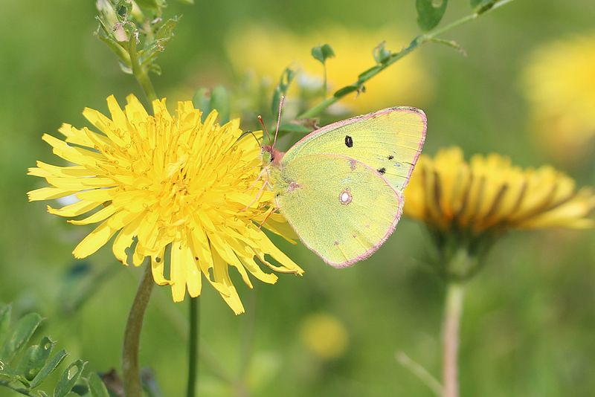
THANK YOU
Any questions? Please reach trainer and module developer:
Husein Zorkot, Lepidopterist, Butterfly Conservationist, BG & P Manager
Email: huseinspnl@gmail.com
Mobile: 76 371 382
Please visit our website, Butterflies and Moths of Lebanon LEPIDOPTERA LIBANOTICA, at http://butterflies.spnl.org/
Husein Zorkot © 2018
Attribute: Alpsdake (Wikipedia Creative Commons)
Prepared by Husein Zorkot
FOXFIRE Environmental Education, SPNL

